Slide 1
CDAWeb and Other SPDF Services
Bobby Candey
Space Physics Data Facility (SPDF) <https://spdf.gsfc.nasa.gov>
Heliophysics Science Division (Code 670)
NASA Goddard Space Flight Center
Third IHDEA meeting 2019 Oct.17

Slide 2
Infrastructure for the Heliophysics Data Environment
Heliophysics Data Portal (HDP)
HDP is a world-wide inventory of public Heliophysics-relevant data
SPDF also uses HDP as our high-level dataset inventory
CDF (Common Data Format) and SPDF Metadata Guidelines
Self-describing data format for storing/using scalar and multi-dimensional data in a platform- and discipline-independent fashion.
Self-documenting through use of global and variable “attributes”, both to the meaning/use of data and dependencies among variables
Associated ISTP/SPDF structuring and metadata guidelines are critical to Heliophysics usability and are applicable beyond data in CDF
APIs to SPDF system capabilities and data
External software and services can leverage SPDF data/services (such as AMDA, Autoplot, IDL, Python libraries)
2

Slide 3
SPDF Services
Archive for non-solar NASA Heliophysics science data and many other missions
CDAWeb browse, correlations and display, simple interface
SSCWeb orbit/ground track data/displays and conjunction queries, 4D viewer
OMNI Database / OMNIweb-Plus (baseline solar wind data at Earth)
Heliophysics Data Portal (HDP) SPASE-based inventory of public Heliophysics-relevant data
CDF self-describing scientific data format
SKTeditor for creating and testing ISTP/SPDF Guidelines metadata (CDF/netCDF)
Master CDF/netCDF concept uses file with no data to add/over-ride metadata in datasets
Web services for CDF/netCDF data in CDAWeb, SSC orbits, OMNIweb, HDP; use REST versions, many language examples
https://cdaweb.sci.gsfc.nasa.gov/WebServices/REST/ (same for SSCweb)
SPDF cited in a third of JGR Blue articles

Slide 4
SPDF Services
Multi-instrument, multi-mission Heliophysics science
(1) Specific mission/instrument data in context of other missions/data
(2) Specific mission/instrument data as enriching context for other data
(3) Ancillary services & software (orbits, data standards, special products)
CDAWeb (browse, correlations and display, simple interface)
Plot, list, subset, and download data in CDF or ASCII format
Primary SPDF data service for currently active mission data
Presents dataset view rather than individual data files
SSCWeb (orbit/ground track displays and queries)
Plot, list orbits of multiple spacecraft in a variety of coordinate systems; query for satellite-satellite and satellite-ground station conjunction. Includes most heliospheric satellites and many ground stations.
4D Orbit Viewer: Interactive 4D animation of orbits
OMNI Database / OMNIweb-Plus (baseline solar wind data at Earth)
Solar wind magnetic field & plasma parameters mapped to Earth’s bowshock
Based on a large volume of quality-controlled satellite measurements (November 1963 ->) plus interface for plotting, filtering, downloading the data

Slide 5
Standards Underpinning SPDF
Data, Products and Services
External Data and Metadata Services
SPDF (& Other)
CDF Libraries
External Data Display and Analysis Software/Services
User Interface
Web Services Interfaces to Data and Services
Server-Based Browse and Correlative Science Services
Data and Metadata Standards and s/w
Physical Data
Archive
User File and Directory Access (FTP, HTTP)
“Master” Metadata Files
Archive Interfaces
Core Archive
External Interfaces
Ongoing Ingest of Current Mission and Other Data for Long-term Active Archiving
5
Notes:
5

Slide 6
SPDF Data Access
All data files (not just CDFs and netCDFs)
Through FTP and HTTP spdf.gsfc.nasa.gov/pub/
For data in CDFs or netCDFs with sufficient metadata:
CDAWeb data browser for plots, lists (text, CSV, JSON), CDFs
CDAS Web Services (REST/SOAP) cdaweb.gsfc.nasa.gov/WebServices/
In IDL cdaweb.gsfc.nasa.gov/WebServices/REST/CdasIdlLibrary.html using CDAWlib IDL library routines spdf.gsfc.nasa.gov/CDAWlib.html
Within Autoplot autoplot.org/help#CDAWeb
HAPI interface to CDAWeb holdings cdaweb.gsfc.nasa.gov/hapi
Not all data can be sent via HAPI
CDAS REST example (CDF fastest but other formats also)
Get a CDF file containing the variables Magnitude and BGSEc data from the AC_H2_MFI dataset in the time range of 2009-06-01T00:00:00 to 2009-06-03T00:00:00
https://cdaweb.gsfc.nasa.gov/WS/cdasr/1/dataviews/sp_phys/datasets/AC_H2_MFI/data/20090601T000000Z,20090603T000000Z/Magnitude,BGSEc?format=cdf

Slide 7
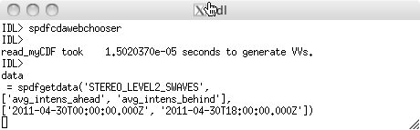
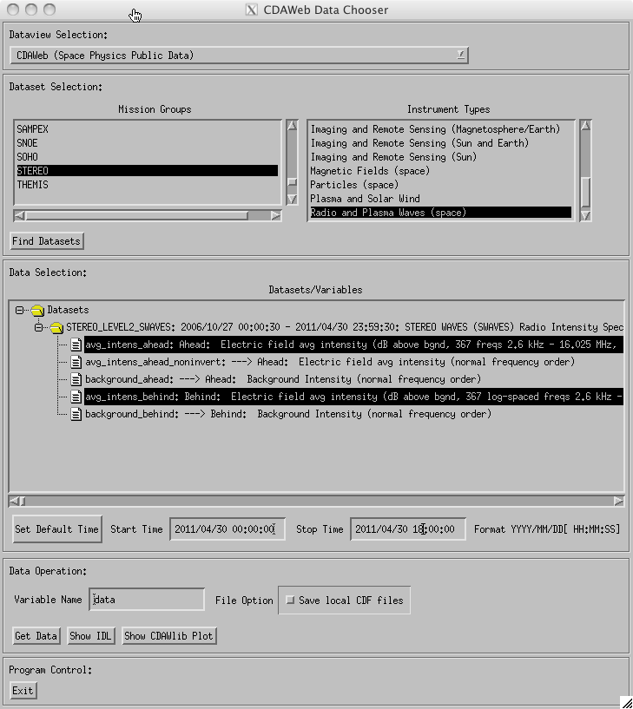
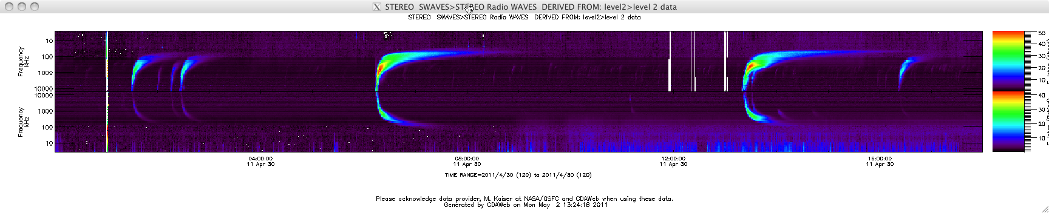
“Fill My (IDL) Array” with Data from CDAWeb
Load specific CDAWeb data into an IDL structure using
@compile_cdaweb
spdfgetdata
GUI to select/load/display data from CDAWeb in IDL
spdfcdawebchooser

Slide 8
Directly Read Data from CDAWeb into IDL
timename='jul_day' ;name of time variable -- Julian days
start_time = '1998-06-10T00:00:00.0Z' ;start time
stop_time = '1998-06-10T23:59:59.0Z' ;stop time
dt_sec=10.0 ;sec -- bin size in seconds
dataset_id='WI_H0_MFI' ; CDAWeb dataset ID
vars=[ 'B3F1=Bmag3', 'B3GSE=Bx3,By3,Bz3'] ; CDAWeb variable names with locally assigned names
cdaweb_get_bin, dataset_id,vars,start_time,
stop_time,dt_sec,time_name=timename
dataset_id='WI_PM_3DP'
vars=[ 'P_DENS=np3', 'P_VELS=Vxp3,Vyp3,Vzp3', 'P_TEMP=Tp3', 'A_DENS=na3', $
'A_VELS=Vxa3,Vya3,Vza3', 'A_TEMP=Ta3']
cdaweb_get_bin, dataset_id,vars,start_time,
stop_time,dt_sec,time_name=timename,/autobad
No more writing code for every dataset.
The Internet functions as a local, easy to use hard drive.
“HAPI” will generalize this to accessing “everything.”
VSO does the same for Solar Data

Slide 9
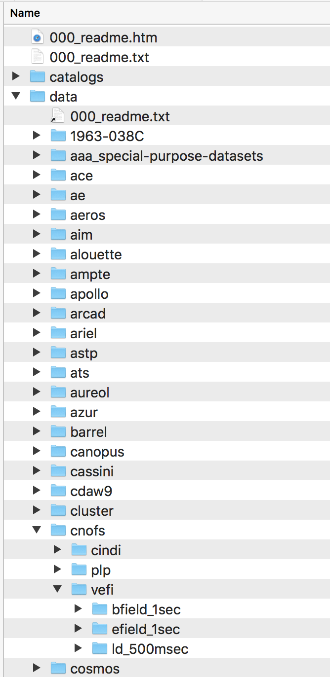
SPDF FTP/HTTPS Directories
…

Slide 10
CDAWeb Interface: Simplicity and Multiple Missions
Missions and Instrument Types
Sample Plots: also can produce ASCII listings and CDF downloads
Variables

Slide 11
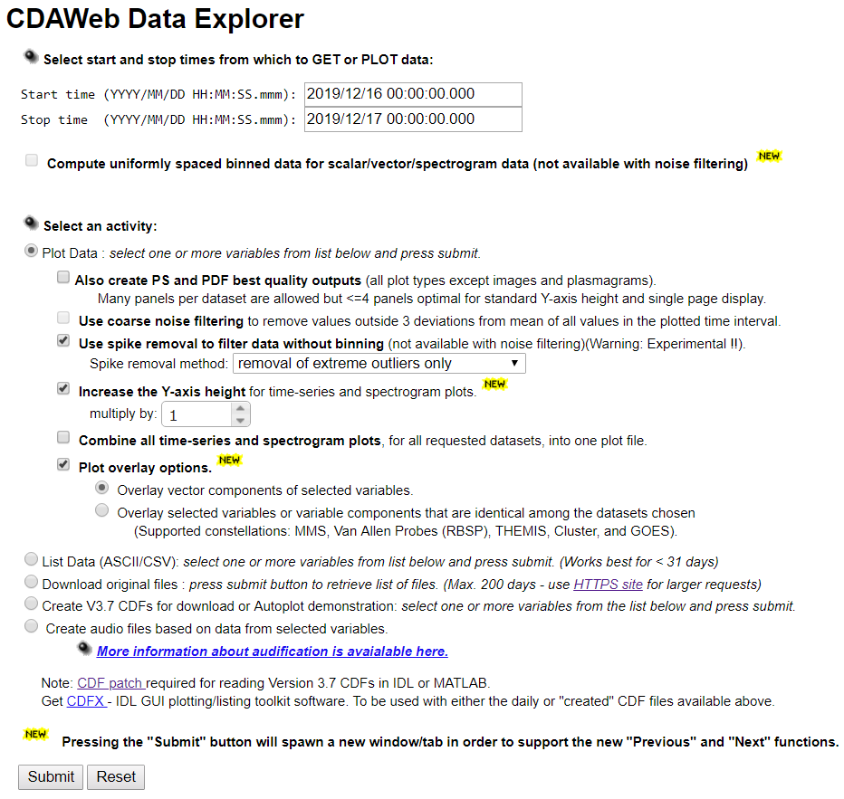
CDAWeb Data Explorer
Automatically set by
the last available day
of the selected data
Options:
noise filtering,
spike removal,
overlay plotting
Notes:
Interface: Simplicity and Multiple Missions

Slide 12
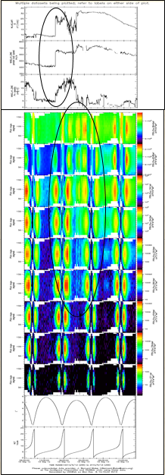
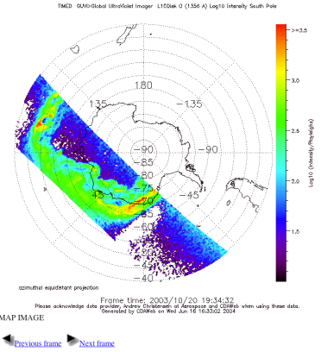
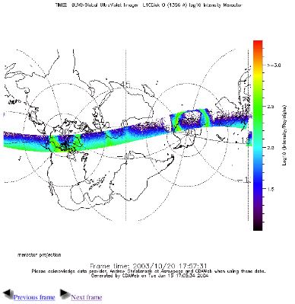
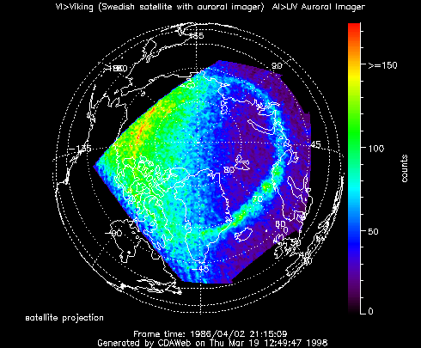
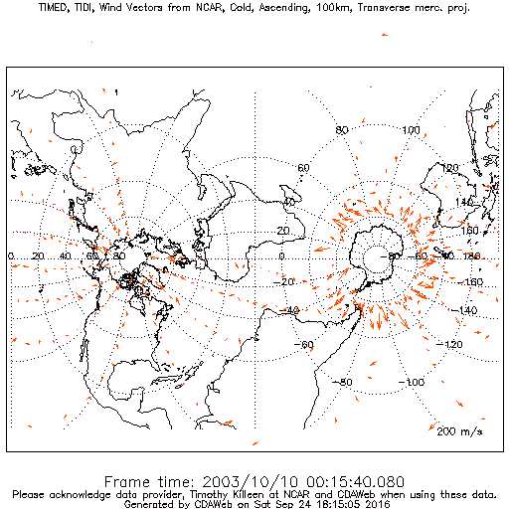
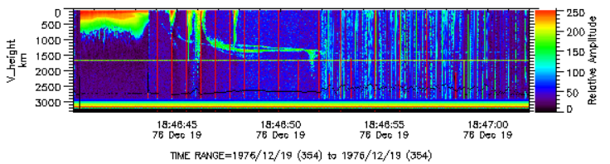
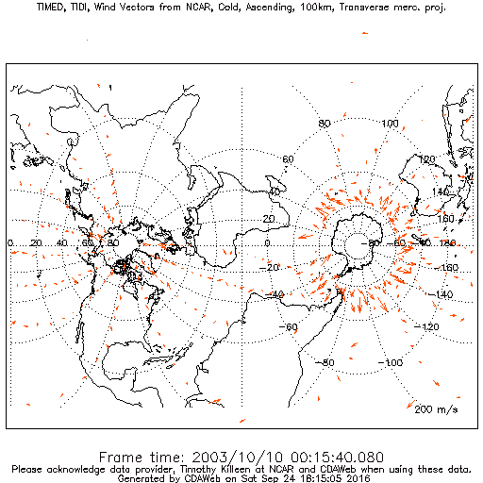
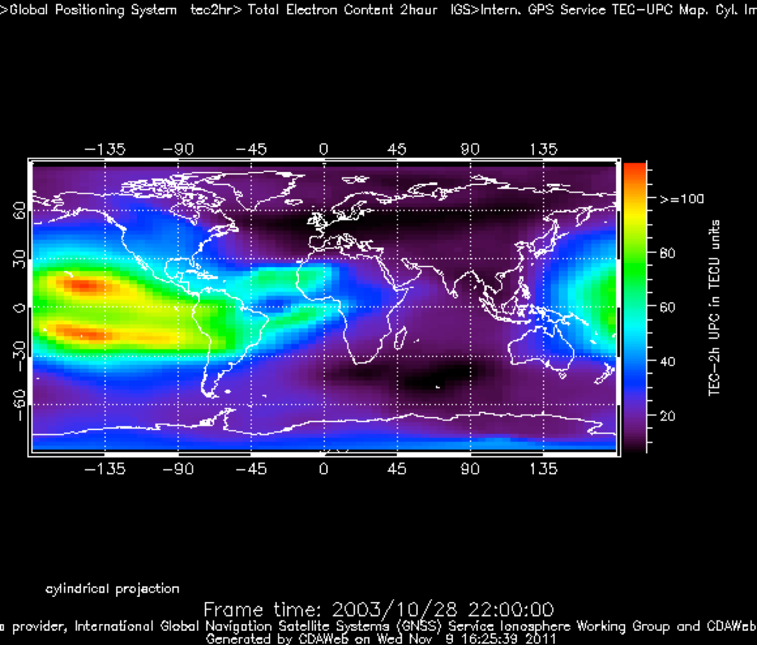
TIMED/GUVI/1356 Å
Polar Projection
TIMED GUVI/1356 Å
Transverse Mercator Projection
Viking(Sweden)/UV Imager/ North Pole
Parameter Display Options in CDAWeb
GPS/IGS/TEC
ISIS-2 Topside Sounder Ionogram
WIND MFI & SWE and Van Allen Probe A ECT & MagEIS
TIMED/TIDI/Wind Vectors
Movie/Transverse Mercator Projection

Slide 13
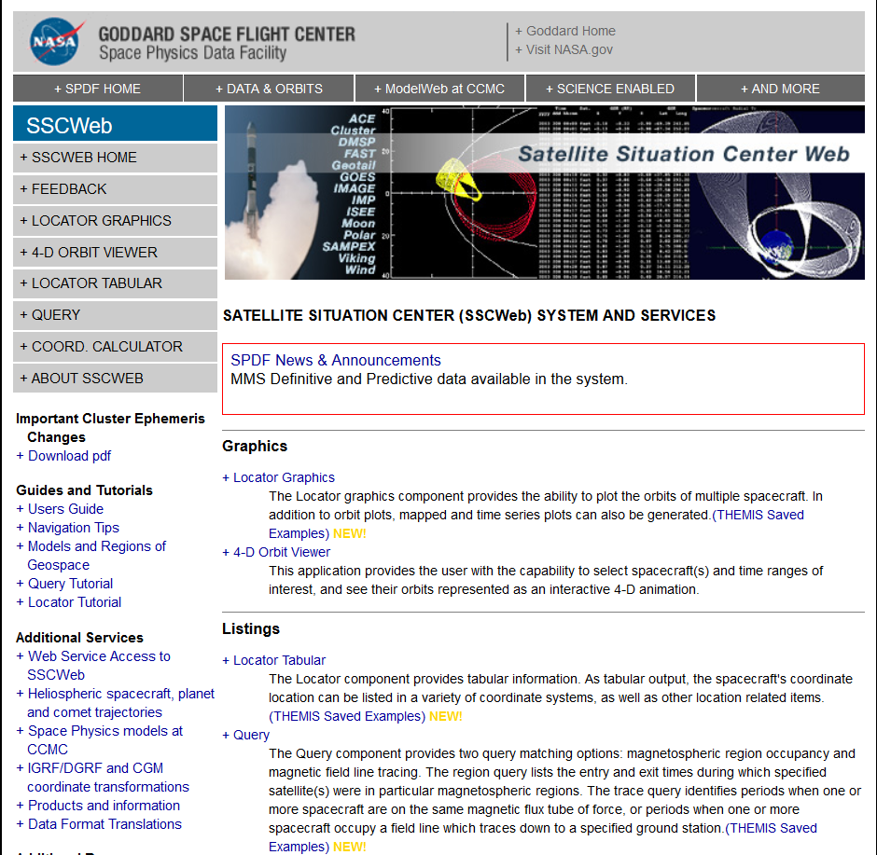
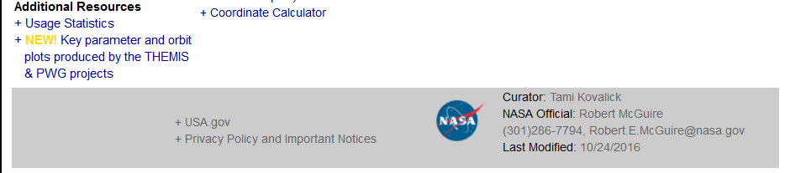

Slide 14
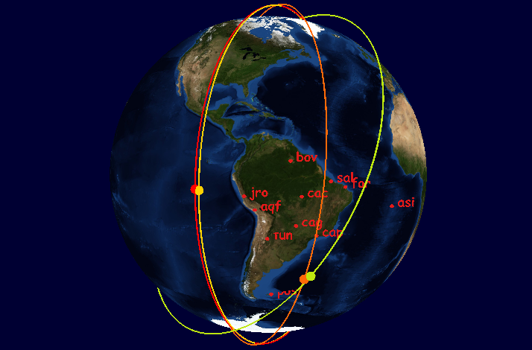

SSCWeb and the 4-D Orbit Viewer
4D Orbit Viewer uses SSCWeb webservices API to access S/C database (CDF)
Extended Orbit Predicts : August 2021
SSCweb also computes radial and magnetic field line conjunctions between satellites and satellite to ground station
Simulated ICON+SWARM coverage in GOLD FOV

Slide 15
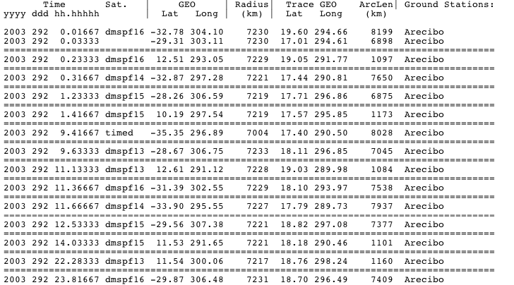
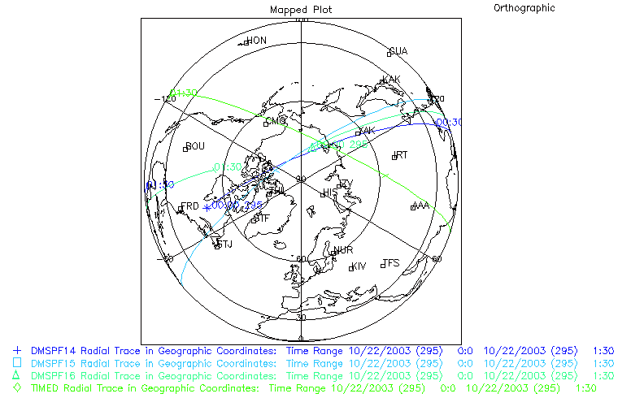
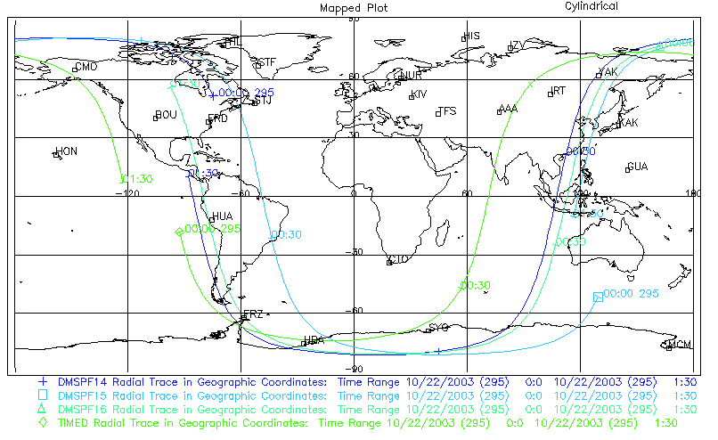
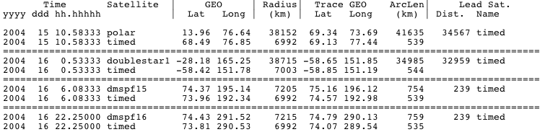
SSCWeb
Multi-satellite and/or satellite - ground station magnetic conjunctions
Listing of times when the magnetic footpoints of TIMED, DMSP 13, 14, 15 or 16 crossed the Arecibo ground station.
Orbit plots for TIMED and DMSP 14, 15, 16 in a Polar or Cylindrical Projection. Ground station 3-letter codes included.
Listing of times of magnetic conjunction between TIMED and Doublestar 1, or DMSP 15 or 16.

Slide 16
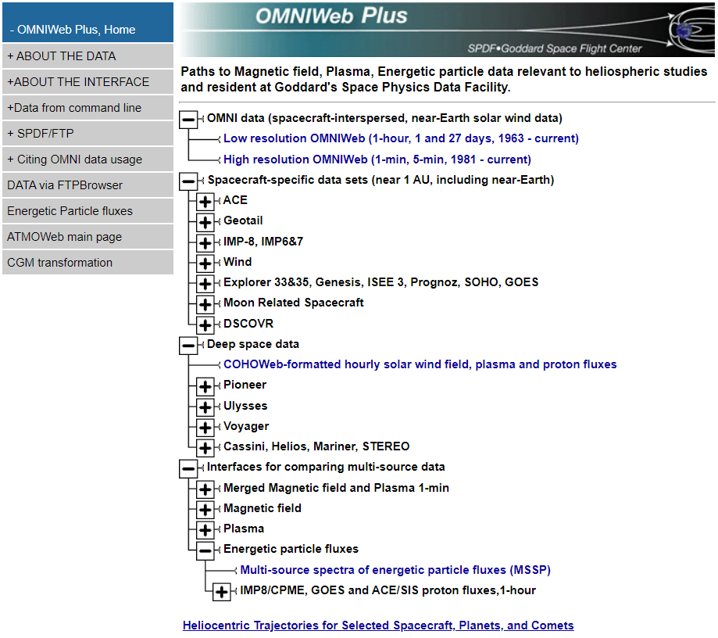
OMNIWeb Plus
OMNI Data: Database of solar wind magnetic field and plasma parameters mapped to the nose of the Earth’s bow shock
Based on a large volume of quality-controlled satellite measurements (since Nov. 1963)
COHOWeb: Solar wind field, plasma, and proton fluxes in other locations of heliosphere, especially useful for planetary studies and heliospheric model validation
Interface for plotting, filtering, and downloading the data

Slide 17
https://spdf.sci.gsfc.nasa.gov/pub/catalogs/all.xml
<dataset ID="ac_h2_cris_cdaweb" nssdc_ID="(None) " serviceprovider_ID="AC_H2_CRIS" timerange_start="1997-08-27 00:00:00"timerange_stop="2018-10-03 23:00:00">
<access filenaming="ac_h2_cris_%Y%m%d_%Q.cdf" protocol="ftp" subdividedby="%Y" timerange_start="1997-08-27 00:00:00"timerange_stop="2018-10-03 23:00:00"> <URL>ftp://cdaweb.gsfc.nasa.gov/pub/data/ace/cris/level_2_cdaweb/cris_h2</URL> </access>
<other_info><link URL="http://www.srl.caltech.edu/ACE/ASC/level2/index.html" title="The ACE Science Center Level 2 Data website"type="documentation"> Release notes and other info available at </link> </other_info>
<observatory ID="AC" nssdc_ID="None" serviceprovider_ID="AC">
<description short="Advanced Composition Explorer"/> </observatory>
<instrument ID="CRIS" nssdc_ID="None" serviceprovider_ID="CRIS">
<description short="ACE Cosmic Ray Isotope Spectrometer"/> </instrument>
<data_producer affiliation="California Institute of Technology" name="E. C. Stone" title="None"/>
<mission_group ID="ACE" serviceprovider_ID="ACE"> <description short="ACE"/> </mission_group>
<instrument_type ID="Particles (space)" serviceprovider_ID="Particles (space)"/>
<description short="ACE/CRIS Cosmic Ray Isotope Spectrometer 1-Hour Level 2 Data - E. C. Stone (California Institute of Technology)"/>
<mastercdf ID="https://cdaweb.gsfc.nasa.gov/pub/software/cdawlib/0MASTERS/ac_h2_cris_00000000_v01.cdf"serviceprovider_ID="https://cdaweb.gsfc.nasa.gov/pub/software/cdawlib/0MASTERS/ac_h2_cris_00000000_v01.cdf"/> </dataset>

