Slide 1
Data formats standards and metadata
Discussion led by Bobby Candey
Space Physics Data Facility (SPDF) <https://spdf.gsfc.nasa.gov>
Heliophysics Science Division (Code 670)
NASA Goddard Space Flight Center
Third IHDEA meeting 2019 Oct.17

Slide 2
Formats in NASA Space Science
Standard formats
  FITS used in astronomy and solar physics [FITS and WCS metadata]
  HDF in Earth sciences [HDF-EOS hdfeos.org metadata]
  netCDF in atmosphere [Climate and Forecast cfconventions.org] and ITM [ISTP/SPDF metadata]
  CDF in the rest of Heliophysics [ISTP/SPDF Guidelines metadata]
PDS added CDF-A as standard format (PDS-3, PDS-4, JPEG): CDF with ISTP/SPDF Guidelines and two SPASE attributes, but no compression or sparse variables
ICON/GOLD metadata uses the ISTP/SPDF guidelines in netCDFs, netCDF4 Classic model with no groups or user-defined variable types, time is unlimited dimension
SPDF has converters between CDF, CDFML, netCDF, HDF, FITS, and to PDS-3

Slide 3
Why metadata conventions
Leverage standardized self-describing data formats, metadata for datasets and parameters, time conventions, and dataset and filenaming conventions to enable effective data analysis and browsing using generic easy-to-use software and web services
Restricting metadata representations limits the number of equivalent possibilities with which software must deal, and thus fosters interoperability
Conventions standardize ways to name things, represent relationships, and locate data in space and time
Enables developing applications with powerful extraction, regridding, analysis, visualization, and processing capabilities
Abstracts general data models to represent data semantics.
Embody provider’s experience and capture the meaning in data and make data semantics accessible to humans as well as programs
Provide higher-level abstractions such as coordinate systems, standard names for physical quantities for comparing different data, and distinguish variables

Slide 4
Some standards and conventions
SPASE <http://www.spase-group.org> dataset descriptions for easy searching
Heliophysics Data Portal <https://heliophysicsdata.sci.gsfc.nasa.gov>
ISTP/IACG/SPDF Guidelines for global and variable attributes <https://spdf.gsfc.nasa.gov/sp_use_of_cdf.html>
  SKTeditor metadata creation tool <https://spdf.gsfc.nasa.gov/skteditor>
  Defining additional standard attributes: Cluster, THEMIS, RBSP (PRBEM), MMS, etc.
Dataset naming and file naming recommendations <http://www.tsds.org/Recommended_file_and_data_collection_naming_practices> and filenaming templates <http://tsds.org/uri_templates> $Y/data_$Y_$j_id$x.cdf
CDF <https://cdf.sci.gsfc.nasa.gov> scientific data format (including its new Python library <https://github.com/MAVENSDC/cdflib>)
  Time variable types <https://cdf.sci.gsfc.nasa.gov/html/leapseconds_requirements.htm>
netCDF <https://www.unidata.ucar.edu/software/netcdf/>
FITS <https://fits.gsfc.nasa.gov/>
UDunits www.unidata.ucar.edu/software/udunits/
Tools enabled by standards: CDAWeb and CDAWlib IDL library,
Autoplot <http://autoplot.org>, SPEDAS <http://spedas.org> IDL library

Slide 5
ISTP/SPDF Guidelines Structure and Metadata Concepts
ISTP/IACG Guidelines (mid1990s) and subsequent extensions by SPDF define a limiting set of implementation standards for CDFs
  Include general file naming conventions
  Data is time-ordered and time-identified; times vary by record
  Set of required and suggested metadata (details on next slide)
  Variable attributes can point to other variables by name and carry arguments
      – Attributes thus carry information about relationships among variables
      – Variables can carry metadata (e.g. labels for dimensional variables)
    Terminology: “Skeleton” CDF is a CDF with structure and metadata defined but no data, so it can be used as a template from which to build a data file
CDAWeb additional concepts: “Master” CDFs and “Virtual” Variables
  “Master” CDF is the use of a “skeleton” CDF to insert supplemental or updated metadata for CDFs as a dataset
  ”Virtual” variables are computed variables, using specialized CDF attributes to link defined variables and routines within CDAWeb/CDAWlib
Concepts above directly/easily map to data in netCDF
5

Slide 6
ISTP/SPDF Metadata Elements
Variable attributes required for automated processing:
  Catdesc for longer variable description
  Depend_0 points to time variables
  Depend_1, 2, 3 point to variables that describe other dimensions
  Fieldnam short variable name for plots
  Fillval values indicating missing or bad data
  Lablaxis/Labl_ptr for axis and column titles
  Units/Unit_ptr
  Validmin/max for valid data range
CDF Time variable types
  CDF_TIME_TT2000 nanoseconds from J2000 in Terrestrial Time in 8 byte integer handles leap seconds and is well-defined; UTC conversion requires up-to-date leap second table (last value stored in CDF header as a check)
  EPOCH milliseconds from 0AD in 8byte float; usually UTC but not leap seconds
  EPOCH16 picoseconds from 0AD in two 8byte float; usually UTC but not leap seconds
ISTP/SPDF Guidelines online at
https://spdf.gsfc.nasa.gov/sp_use_of_cdf.html

Slide 7
CDF in More Detail
Software distribution APIs: C, C#, VisualBasic, Java, Perl, Fortran
  Stable, fully functional
    Built-in compression capability and transparent decompression
    CDF includes an internal checksum to ensure integrity
    CDFconvert utility to optimize internal layout
    Multiple standard format translators
  Utilities for modifying CDFs and to/from regular text or XML (CDFML) files
  Support libraries for IDL and MATLAB (included in their distributions)
  Additional CDAWlib distribution includes rich set of IDL procedures
3 additional independent implementations for reading/writing CDFs
  Bryan Harter’s pure Python github.com/MAVENSDC/cdflib
  Mark Taylor’s pure Java JCDF library (CDF read only)
    Used by TOPCAT and STILTS. See www.star.bristol.ac.uk/~mbt/jcdf
  Nand Lal’s pure Java CDFJ library (now included in SPDF’s CDF distribution)

Slide 8
A Useful Tool: Create/Edit a Skeleton file compliant to ISTP/SPDF standard
SKTEditor is a Java, web-start application
  Guide designers to good choices consistent with ISTP/SPDF guidelines
  Create new CDF ..or... check/correct then modify an existing skeleton file
  Now supports netCDF
Guided by the interface flow, add or edit
  Scalar and higher-dimensional variables, multiple time variables
    Times as cdf_epoch or as cdf_time_tt2000
  Variable attributes (descriptions, labels, units, display_type)
  Global attributes and file naming
  Virtual variables (functions in CDAWlib, compute values on-the-fly)
Checking and validation functions
  Against ISTP/SPDF standards
  For PRBEM, MMS or other specified project compliance reporting
8

Slide 9
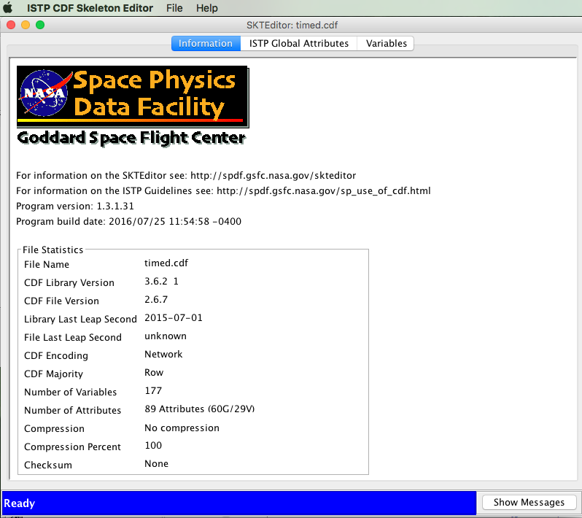
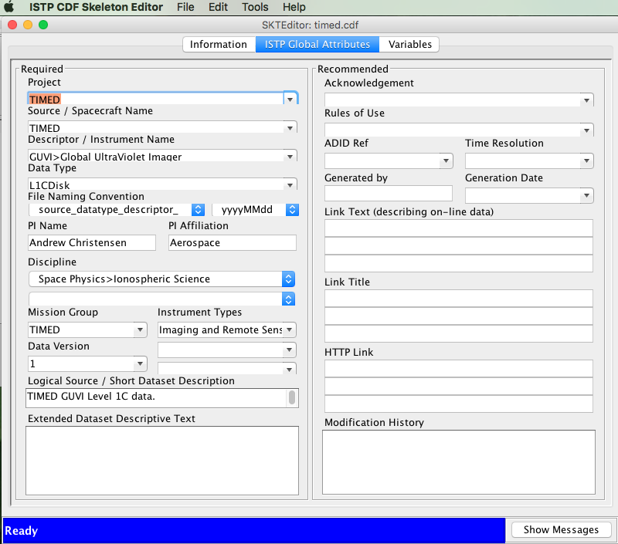
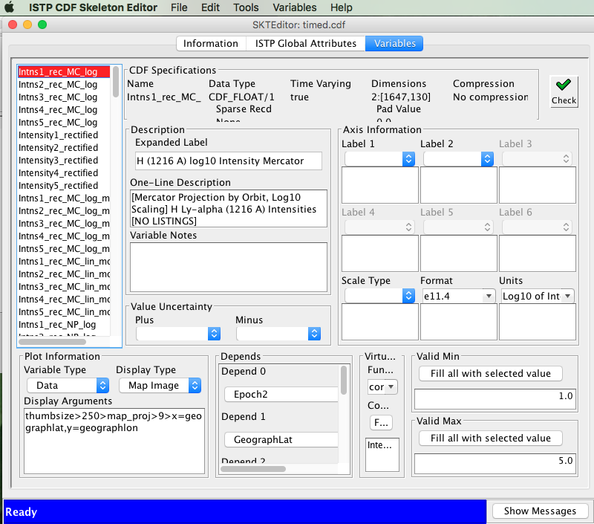
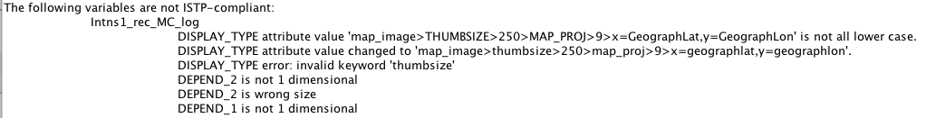
SKTEditor

Slide 10
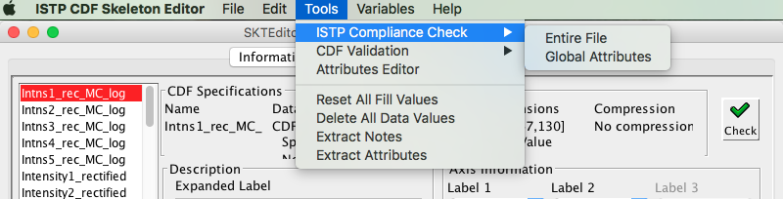
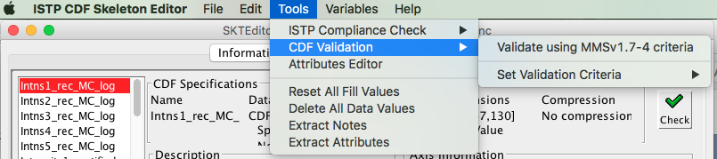
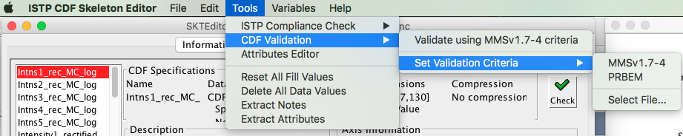
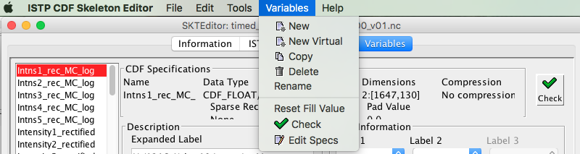

Slide 11
Creating an ISTP/IACG Skeleton CDF:
Understand the Data to be Loaded
What are the key data quantities
  What is their definition/meaning?
  How are they going to be named?
    N.B. MMS parameter naming convention: scId_instrumentID_paramName
Understand (at the dataset level)
  Dimensionality and dependencies
  Variance with time and dimension
    ISTP/SPDF conventions allow >1 time variable in a file
    Carry slowly-varying data as variables rather than in attributes
General rule is to capture relationships in the structure
  Otherwise capture relationships in variable attributes
  Want relationships to be logically-structured and machine-readable
    Available for more general-purpose codes to exploit
Let CDF deal with mechanics of efficient data storage
  Once more: lay out data by what’s science logical and useful
    E.g. methods to handle slowly-varying data include setting “sparse=sRecords.PREV”

Slide 12
The MakeCDF Program
Highly relevant to teams with an internal format like csv
Engine+Data+FileFormatDescription+Skeleton CDF = Output CDF
  Capable of supporting both ASCII and BINARY files, multiple time formats
  Can automatically skip header records (or be manually controlled)
  (Optional) arguments allow handling complex inputs; e.g. sub-records
File Format Description (FFD) or Translation File defines
  Mapping of data values to named CDF variables
  Data format of input data
Example Input (specifically Geotail CPI plasma data made into csv)
    2007,304,0,1,10,102,0.4400E+03,0.91000E+02,0.18230E+03,-.43958E+03,-.17655E+02,-.76791E+01,0.1050000E+06,0.78900E+01,0.3055E+01
    2007,304,0,2,48,842,0.4420E+03,0.90900E+02,0.18180E+03,-.44173E+03,-.13882E+02,-.69426E+01,0.1230000E+06,0.78000E+01,0.3048E+01
    2007,304,0,4,24,590,0.4370E+03,0.90600E+02,0.18040E+03,-.43697E+03,-.30506E+01,-.45762E+01,0.1310000E+06,0.58800E+01,0.2246E+01

Slide 13
Major CDAWlib routines
READ_MYCDF - The function READ_MYCDF reads from one to many variables from one to many CDF files (in one dataset), and returns all data and metadata for these variables in a single structure
PLOTMASTER - This function accepts from 1 to 10 structures of the type returned by READ_MYCDF, determines the plot type for each variable in each of the structures, and plots each (to either an X window or GIF file). Returns a 0 if plotting was successful, and a -1 if unsuccessful.
LIST_MYSTRUCT - Given a "data structure" read with read_mycdf, LIST_mystruct generates an ascii listing of the data
WRITE_MYCDF - This function accepts from 1 to 10 structures of the type returned by READ_MYCDF, produces a cdf file for each structure.
  Each have many keywords, please see the code for those

Slide 14
SPDF Services to Support netCDF
Use the ISTP/SPDF metadata/structure guidelines and “master” files
Support ingest/distribution of data through CDAWeb
  CDAWeb system extended to read/write data in netCDF using same IDL structures used for CDFs
  Enables access through existing webservices APIs
  SKTEditor tool extended to read/write netCDF
GOLD and ICON agreed to try to follow ISTP/SPDF metadata and structure standards in producing netCDF4 data products
  SPDF further enhanced CDF <-> netCDF conversion software
  SPDF created an IDL script to address a specific netCDF structuring issue
Expect to leverage this new netCDF capability for other datasets
  New high-resolution GOES science data from NOAA (including 16 and 17)
  Improved support for older Heliophysics missions (mainly ITM) that used netCDF but without ISTP/SPDF metadata and structure standards

Slide 15
netCDF Issues
No predefined time variable types
  Time not always the unlimited dimension
  CDAWeb adds CDF_TIME_TT2000 virtual variables for netCDF datasets, computed from various time schemes (base time, time units)
CDAWeb adds missing Fillval, Validmin/max, Var_type, depend_0, and other attributes
netCDF to CDF converter adds attributes to store version, dimensions, sizes, compression, chunking, and string (not character) information
CDF to netCDF converter converts time variables to binary or encoded string forms
Compression requires careful block size determination
Supports only netCDF4 Classic model with no groups or user-defined variable types

Slide 16
Some Recent CDF updates
Improved CDFML format
Added ISO-8601 time outputs to utilities
Added leap second header to flag outdated leap second table
Improved temporary file and directory handling
Added new modular CDFread C-based functions
Allowed Null-terminating string for variable data and attribute entries
Allowed multiple strings for variable attribute entry
Added support for ARM architecture
Added Itanium IA64 on OpenVMS
Added pure Java package, cdfj.jar, for CDF read/write
And miscellaneous bug fixes and performance tweaks

Slide 17
Upcoming Activities
CDF
  ongoing maintenance, performance improvements
  CDF beginners guide
  Python library: add WCS time conversions
  Adapt netCDF command line tools like NCO.sf.net for CDFs for operations on files
ISTP/SPDF Guidelines
  Will soon add SPASE and DOI global attributes to CDAWeb datasets via Master CDFs when available and expose in CDAWeb interface
  Better document Guidelines on Github with mission-specific metadata as well, but want to keep flexible for interactions with missions and enabling framework for CDAWeb services
Rewrite SKTeditor in Javascript or similar and include SPASE fields
Changes are driven by active archiving needs and new technology
17
Notes:
NCO reads netCDFs for

Slide 18
https://spdf.sci.gsfc.nasa.gov/pub/catalogs/all.xml
<dataset ID="ac_h2_cris_cdaweb" nssdc_ID="(None) " serviceprovider_ID="AC_H2_CRIS" timerange_start="1997-08-27 00:00:00"timerange_stop="2018-10-03 23:00:00">
<access filenaming="ac_h2_cris_%Y%m%d_%Q.cdf" protocol="ftp" subdividedby="%Y" timerange_start="1997-08-27 00:00:00"timerange_stop="2018-10-03 23:00:00"> <URL>ftp://cdaweb.gsfc.nasa.gov/pub/data/ace/cris/level_2_cdaweb/cris_h2</URL> </access>
<other_info><link URL="http://www.srl.caltech.edu/ACE/ASC/level2/index.html" title="The ACE Science Center Level 2 Data website"type="documentation"> Release notes and other info available at </link> </other_info>
<observatory ID="AC" nssdc_ID="None" serviceprovider_ID="AC">
<description short="Advanced Composition Explorer"/> </observatory>
<instrument ID="CRIS" nssdc_ID="None" serviceprovider_ID="CRIS">
<description short="ACE Cosmic Ray Isotope Spectrometer"/> </instrument>
<data_producer affiliation="California Institute of Technology" name="E. C. Stone" title="None"/>
<mission_group ID="ACE" serviceprovider_ID="ACE"> <description short="ACE"/> </mission_group>
<instrument_type ID="Particles (space)" serviceprovider_ID="Particles (space)"/>
<description short="ACE/CRIS Cosmic Ray Isotope Spectrometer 1-Hour Level 2 Data - E. C. Stone (California Institute of Technology)"/>
<mastercdf ID="https://cdaweb.gsfc.nasa.gov/pub/software/cdawlib/0MASTERS/ac_h2_cris_00000000_v01.cdf"serviceprovider_ID="https://cdaweb.gsfc.nasa.gov/pub/software/cdawlib/0MASTERS/ac_h2_cris_00000000_v01.cdf"/> </dataset>

Slide 19
Backup slides

Slide 20
SPDF Services
Archive for non-solar NASA Heliophysics science data and many other missions
CDAWeb browse, correlations and display, simple interface
SSCWeb orbit/ground track data/displays and conjunction queries, 4D viewer
OMNI Database / OMNIweb-Plus (baseline solar wind data at Earth)
Heliophysics Data Portal (HDP) SPASE-based inventory of public Heliophysics-relevant data
CDF self-describing scientific data format
SKTeditor for creating and testing ISTP/SPDF Guidelines metadata (CDF/netCDF)
Master CDF/netCDF concept uses file with no data to add/over-ride metadata in datasets
Web services for CDF/netCDF data in CDAWeb, SSC orbits, OMNIweb, HDP; use REST versions, many language examples
  https://cdaweb.sci.gsfc.nasa.gov/WebServices/REST/ (same for SSCweb)
SPDF cited in a third of JGR Blue articles

Slide 21
SPDF Data Access
All data (not just CDFs and netCDFs) through FTP and HTTP spdf.gsfc.nasa.gov/pub/
https://spdf.sci.gsfc.nasa.gov/pub/catalogs/all.xml and SPASE records
CDAWeb data browser for plots, lists (text, CSV, JSON), CDFs, audio
Web Services in REST and SOAP cdaweb.gsfc.nasa.gov/WebServices/
In IDL cdaweb.gsfc.nasa.gov/WebServices/REST/CdasIdlLibrary.html using CDAWlib IDL library routines spdf.gsfc.nasa.gov/CDAWlib.html
Within Autoplot autoplot.org/help#CDAWeb
HAPI interface to CDAWeb holdings cdaweb.gsfc.nasa.gov/hapi
Get a CDF file containing the variables Magnitude and BGSEc data from the AC_H2_MFI dataset in the time range of 2009-06-01T00:00:00 to 2009-06-03T00:00:00: https://cdaweb.gsfc.nasa.gov/WS/cdasr/1/dataviews/sp_phys/datasets/AC_H2_MFI/data/20090601T000000Z,20090603T000000Z/Magnitude,BGSEc?format=cdf

Slide 22
Infrastructure for the
Heliophysics Data Environment
Heliophysics Data Portal (HDP)
  HDP is a world-wide inventory of public Heliophysics-relevant data
  SPDF also uses HDP as our high-level dataset inventory
CDF (Common Data Format) and SPDF Metadata Guidelines
  Self-describing data format for storing/using scalar and multi-dimensional data in a platform- and discipline-independent fashion.
  Self-documenting through use of global and variable “attributes”, both to the meaning/use of data and dependencies among variables
  Associated ISTP/SPDF structuring and metadata guidelines are critical to Heliophysics usability and are applicable beyond data in CDF
APIs to SPDF system capabilities and data
  External software and services can leverage SPDF data/services (such as AMDA, Autoplot, IDL, Python libraries)
22

Slide 23
Basic Definitions: What is CDF?
Common Data Format (CDF)
  Self-describing data format for the storage and manipulation of scalar and multidimensional data in a platform- and discipline-independent fashion
  Actual data format which CDF utilizes is intended to be completely transparent to the user and accessible through a consistent set of interface routines
    Programmers are not burdened with performing low level I/O's to physically format and un-format data files
    Built-in compression capability and transparent decompression
    Library core is pointer logic that maps to/from block data implementation
    CDF includes an internal checksum to ensure integrity
Software distribution includes C, Java, Perl and Fortran APIs
  High-level toolkit of utilities for creating, browsing and modifying CDF data to/from a regular text or XML files
  Support libraries for IDL and MatLab (included in their distributions)
  Additional CDAWlib distribution includes rich set of IDL procedures

Slide 24
SPDF adding netCDF support
As a Heliophysics Final Archive
  Work closely with ICON/GOLD teams, and the relevant Heliophysics Virtual Observatory, to understand planned and actual data products
  SPDF archival formats are NOT restricted to CDF nor is metadata restricted to follow ISTP/SPDF Guidelines but Guidelines important to services
Help support creation and use of ICON/GOLD metadata to the ISTP/SPDF guidelines in the netCDF format
  Use of data/metadata standard generally aids science within mission
  Use of data/metadata standard generally enables easier community access
  Use of data/metadata standard enables use of data in generic tools
  SPDF has extended its SKTEditor tool to read/write netCDF
Support ingest/distribution of data through CDAWeb
  Requires SPDF to extend CDAWeb system to read/write data in netCDF
  Will enable access through existing webservices APIs
  Multiple ways SPDF can ingest data

Slide 25
Presently Low Priority Directions
CDF libraries, tools and wrappers
  Add SWIG.org to support GDL, Octave, etc.; support Excel, WebWinds
  Get Opendap working with latest CDF versions
  Add groups, parent-child relationship [complicates generic software]
  Layer CDF API on HDF-5 as netCDF did [pure Python CDF library better than heavy HDF library]
  Streaming CDFs
  Parallel or in-memory compression for higher performance
  Support UDunits www.unidata.ucar.edu/software/udunits/
ISTP/SPDF Guidelines
  Port SKTeditor to Javascript
  Add naming spaces to attribute names, SPDF_*
CDFlib (IDL)
  Add naming spaces for our routines, SPDF_*

Slide 26
Recommended Steps to Put Data into CDF
Define and create the CDF structure to receive the data
  Create/edit skeleton CDF
    Use SKTEditor
    Use Skeletontable and SkeletonCDF programs
  Science-driven design
Use one of multiple technical options to add data
  In IDL, e.g. use IDLmakeCDF procedures
  Use makeCDF tool
  Direct writes to CDF using CDF library
-------------------------------------------
N.B. For data in another standard self-describing format, SPDF’s translation software can convert data files into CDF
  E.g. netCDF, HDF, FITS
26

Slide 27
Examples of CDF Variables
A simple scalar (e.g. B magnitude) is
  Dimension 0 and record-varying
    By convention, time dependence is captured as record variance
Vector B might be
  1 time-dependent/record-varying variable of dimension 1 and size 3
  OR it could be (not recommended) 3 time-dependent scalars (dimension 0)
Flux at 10 energies should be
  1 time-dependent variable of dimension 1 and size 10
  Plus an attribute pointing to another variable with numerical values for these 10 energies (even if they don’t vary in time)
  AND/OR an attribute pointing to another variable with e.g. energy band (time-independent) identifications (for labeling)
Flux at 10/20 energies and 16/8 pitch angles should be
  1 time-dependent variable of dimension 2 and sizes (20,16) (i.e. max dims)

Slide 28
ISTP/SPDF Metadata Guidelines
ISTP/IACG Guidelines (mid1990s) and subsequent extensions by SPDF define a set of implementation standards for CDFs
  General file naming conventions
  Data is time ordered and time-identified; times vary by record
  Set of required and suggested metadata
  Variable attributes can point to other variables by name
    – Attributes thus carry information about relationships among variables
    – Variables can carry metadata (e.g. labels for dimensional variables)
CDAWeb uses the additional concepts of “Skeleton” and “Master” CDFs
  “Skeleton” CDF is a CDF with structure and metadata defined but no data, so it can be used as a template from which to build a data file
  “Master” CDF is the use of a “skeleton” CDF to insert supplemental or updated metadata for CDFs in a dataset
CDAWeb display service (CDAWlib software using IDL) and services are keyed to data and master CDFs that follow the above Guidelines
Concepts above directly/easily map and can fully apply to data in netCDF
Plan to systematize Guidelines but keep flexible for missions and CDAWeb
28

Slide 29
Key Metadata Guidelines
ISTP/SPDF Guidelines spdf.gsfc.nasa.gov/sp_use_of_cdf.html
Variable attributes required for automated processing:
  Catdesc for longer variable description
  Depend_0 points to time variables
  Depend_1, 2, 3 point to variables that describe other dimensions
  Fieldnam short variable name for plots
  Fillval values indicating missing or bad data
  Lablaxis/Labl_ptr for axis and column titles
  Units/Unit_ptr
  Validmin/max for valid data range
Will soon add SPASE and DOI global attributes to CDAWeb datasets
CDF Time variable types
  CDF_TIME_TT2000 nanoseconds from J2000 in Terrestrial Time in 8 byte integer handles leap seconds and is well-defined; UTC conversion requires up-to-date leap second table (last value stored in CDF header as a check)
  EPOCH milliseconds from 0AD in 8byte float; usually UTC but not leap seconds
  EPOCH16 picoseconds from 0AD in two 8byte float; usually UTC but not leap seconds

Slide 30
Reading CDFs
Data from CDAWeb can be readily displayed/subsetted in CDAWeb
Use SPDF/CDF Data Translation software to FITS, HDF, netCDF, PDS3, CDFML
Use CDF toolkit functions (CDFexport) to make ASCII or XML
Use Autoplot.org
Project CDFs are handled by various project software routines (e.g. SPEDAS)
In IDL: for CDFs written to the ISTP/IACG/SPDF Guidelines
  Value-added CDAWlib functions (that underlie CDAWeb)
  Value-added display program (CDFX) built on CDAWlib
Use IDL or MatLab to read/write and manipulate data
  Using CDF supplied functions included in IDL or MatLab distributions
Python library and recently-developed generic read routines
Write custom C, Fortran, Perl, C# or Java programs using CDF APIs

Slide 31
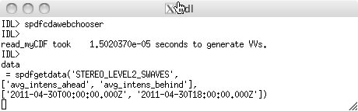
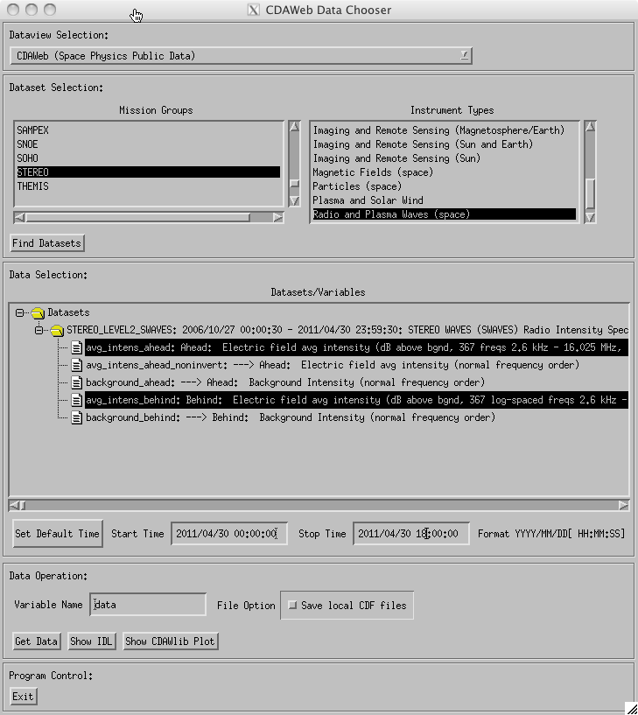
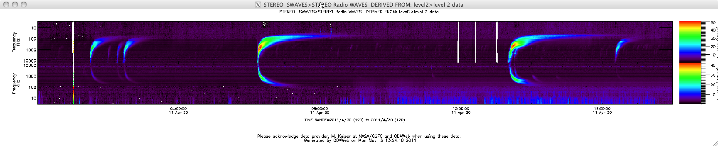
“Fill My (IDL) Array” with Data from CDAWeb
Load specific CDAWeb data into an IDL structure using
  @compile_cdaweb
  spdfgetdata
GUI to select/load/display data from CDAWeb in IDL
  spdfcdawebchooser

Slide 32
I Have A Data File in CDF:
Now What?
Data from CDAWeb can be readily displayed/subsetted in CDAWeb
Use SPDF/CDF Data Translation software
Use CDF toolkit functions (CDFExport) to make ASCII or XML
Use Autoplot (www.autoplot.org)
Project CDFs are handled by various project s/w routines (e.g. TDAS)
In IDL: for CDFs written to the ISTP/IACG/SPDF Guidelines
  Value-added CDAWlib functions (that underlie CDAWeb)
  Value-added display program (CDFX) built on CDAWlib
Use IDL or MatLab to read/write and manipulate data
  Using CDF supplied functions included in IDL or MatLab distributions
Write custom C, Fortran, Perl, C# or Java programs using CDF APIs

Slide 33
Directly Read Data from CDAWeb into IDL
timename='jul_day' ;name of time variable -- Julian days
start_time = '1998-06-10T00:00:00.0Z' ;start time
stop_time = '1998-06-10T23:59:59.0Z' ;stop time
dt_sec=10.0 ;sec -- bin size in seconds
dataset_id='WI_H0_MFI' ; CDAWeb dataset ID
vars=[ 'B3F1=Bmag3', 'B3GSE=Bx3,By3,Bz3'] ; CDAWeb variable names with locally assigned names
cdaweb_get_bin, dataset_id,vars,start_time,
stop_time,dt_sec,time_name=timename
dataset_id='WI_PM_3DP'
vars=[ 'P_DENS=np3', 'P_VELS=Vxp3,Vyp3,Vzp3', 'P_TEMP=Tp3', 'A_DENS=na3', $
'A_VELS=Vxa3,Vya3,Vza3', 'A_TEMP=Ta3']
cdaweb_get_bin, dataset_id,vars,start_time,
stop_time,dt_sec,time_name=timename,/autobad
No more writing code for every dataset.
The Internet functions as a local, easy to use hard drive.
“HAPI” will generalize this to accessing “everything.”
VSO does the same for Solar Data

Slide 34
Notes on CDF and netCDF
CDF and netCDF come from a common heritage
  CDF started in 1984 on Modcomp computer and converted to C in 1990; netCDF development started in 1988
  Self-describing data formats for the storage & manipulation of scalar and multidimensional data in a platform- and discipline-independent fashion
  Actual data layout utilized is intended to be transparent to the user and accessible through a consistent set of interface routines
    Noting the underlying layout is described and directly accessible also
  Interface routines and underlying implementation are different
Common concepts
  Variables generally carry data
  Data can be scalar or multi-dimensional
  Attributes generally carry metadata (i.e. information about data)
    Global (file level) attributes
    Variable level attributes
PDS defined CDF-A as a version of CDF with ISTP/SPDF Guidelines and 2 SPASE attributes, but no compression or sparse variables
Converters between CDF, CDFML, netCDF, HDF, FITS
34

Slide 35
Two CDF Concepts
Variables generally carry data
  Variables can vary/not vary with record (typically time) and 0 or more dimensions
  Variables will also sometimes carry metadata (e.g. labels for dimensional variables)
Attributes generally carry metadata (i.e. information about data)
  Two levels of attributes
    Global (file level) attributes
    Variable level attributes
Variable attributes can point to other variables
  Can thus carry information about relationships among variables
  Can thus use variables to carry metadata (e.g. labels for dimensional variables)
Some standard attributes are defined in CDF library,
  Additional standard attributes defined in the ISTP/SPDF Guidelines
  Projects or communities can/have defined additional standard attributes
    E.g. Cluster, THEMIS, RBSP (PRBEM extensions)

Slide 36
Notes on CDF and netCDF
CDF and netCDF come from a common heritage in PLDS CDF
  Self-describing data formats for the storage & manipulation of scalar and multidimensional data in a platform- and discipline-independent fashion
  Actual data layout utilized is intended to be transparent to the user and accessible through a consistent set of interface routines
Common concepts
  Variables generally carry data
  Data can be scalar or multi-dimensional
  Attributes generally carry metadata (i.e. information about data)
    Global (file level) attributes
    Variable level attributes
SPDF has well-tested converter between CDF and netCDF
  Also ability to output CDF attributes and data in XML (CDFML)
  Also nominal converters to/form CDF to HDF, FITS, and PDS-3
36

