Slide 1
Space Physics Data Facility (SPDF)
Robert Candey, Lan Jian
Third IHDEA Meeting
Lanham, MD
October 16, 2019

Slide 2
Introduction of SPDF
SPDF is the active and final archive of in situ data from NASA heliophysics missions, including collaboration missions with other US and/or foreign agencies

Slide 3
Introduction of SPDF
SPDF is the active and final archive of in situ data from NASA heliophysics missions, including collaboration missions with other US and/or foreign agencies
We also archive other data relevant to NASA heliophysics science objectives
      Related data from planetary missions (e.g., MESSENGER, MAVEN, New Horizons)
      Heliophysics data from some NOAA and DOD satellites (e.g., GOES, DSCOVR)
      Ground-based magnetometers, aurora cameras, radars, etc., which are funded by NSF or other agencies/programs
The data covers the space from the Sun to the local interstellar medium, including magnetosphere, ionosphere, thermosphere, and/or mesosphere (M-ITM) of Earth and other applicable planets
Notes:
International Space Weather Initiative (ISWI)

Slide 4
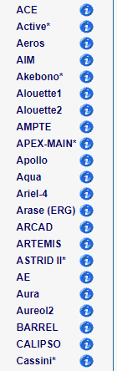
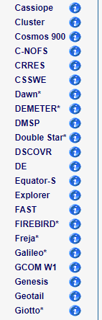
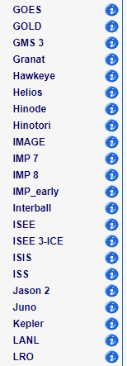
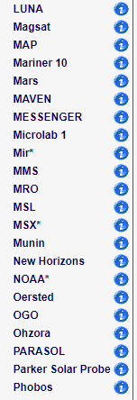
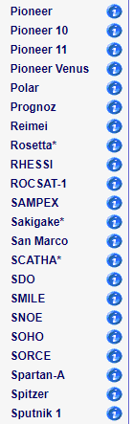
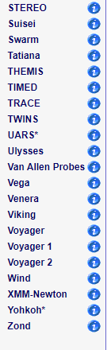
131 Missions Supported by SPDF
https://spdf.gsfc.nasa.gov/data_orbits.html
* Only orbit data available
Total: ~10,000 datasets, ~300 TB data
Recent average monthly data ingestion rate: ~0.6 million data files, ~13.7 TB data
Notes:
Data from 90+ missions include some display/list services, ~175 Ground Stations and ~35 Balloons
SSCWeb/4D Orbit Viewer ephemeris DB ~180 missions
Number of datasets ~1500; distinct variables (CDAWeb) ~36,000
Total number of files archived ~40 M
including both new and reprocessed data

Slide 5
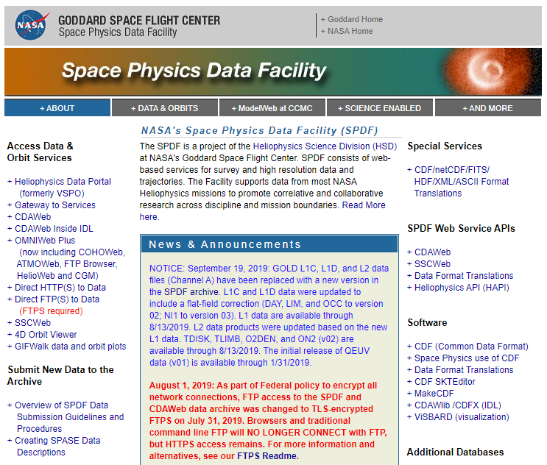
https://spdf.gsfc.nasa.gov/
Bobby’s talk
tomorrow

Slide 6
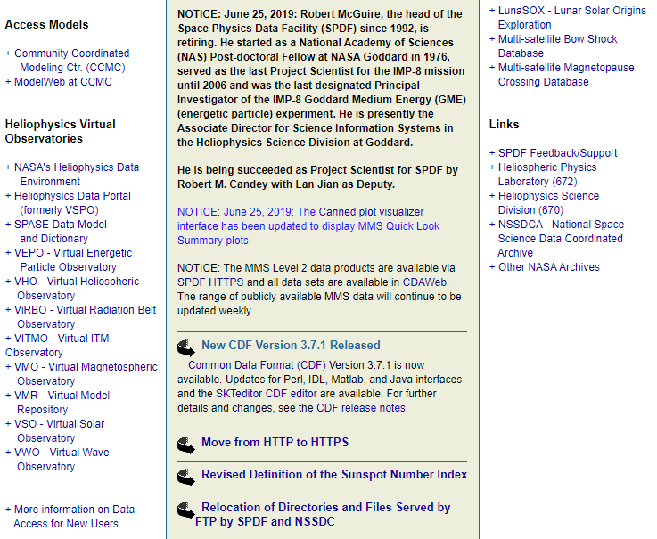
https://spdf.gsfc.nasa.gov/ (cont.)
To subscribe, send an email to
gsfc-spdf-announcements-subscribe
@lists.nasa.gov

Slide 7
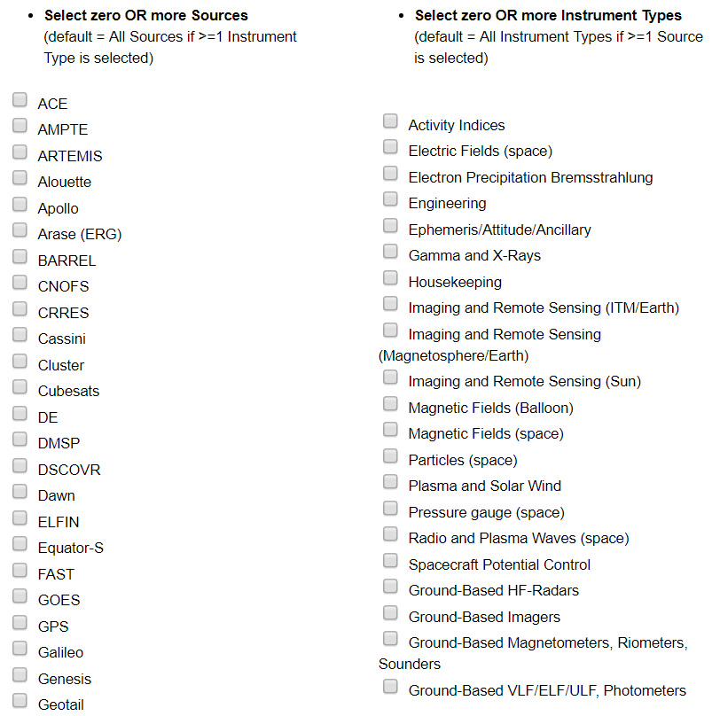
Science-Enabling Service # 1
Coordinated Data Analysis Web (CDAWeb)
70 Missions/Sources
Present dataset view rather than individual data files
Plot, list, and correlate data
Download full or a subset of data in CDF or ASCII format
Special data sources in development
  Cubesats: CSSWE (Colorado Student Space Weather Experiment)
  Sounding Rockets: RENU2 (Rocket Experiment for Neutral Upwelling 2)
  Ground-based investigations: CANOPUS, DARN, SESAME, high and low latitude chains of magnetometer stations
Notes:
BARREL (Balloon Array for Radiation-belt Relativistic Electron Losses), working with Van Allen Probes

Slide 8
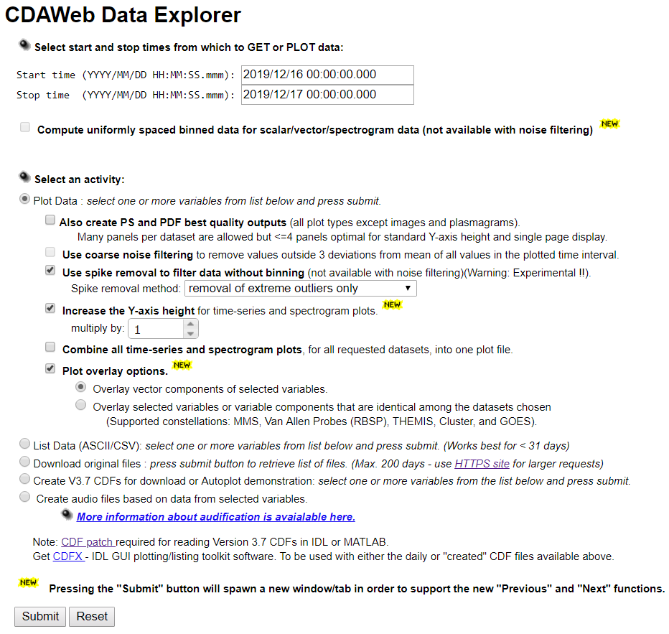
CDAWeb
Data Explorer
Automatically set by
the last available day
of the selected data
Options:
noise filtering,
spike removal,
overlay plotting
Notes:
Interface: Simplicity and Multiple Missions

Slide 9
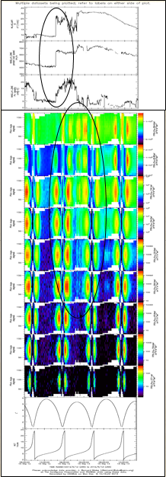
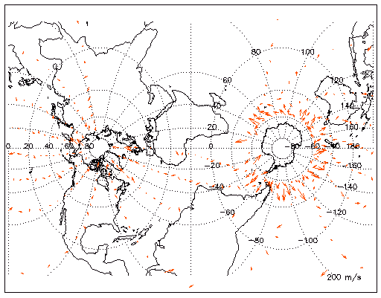
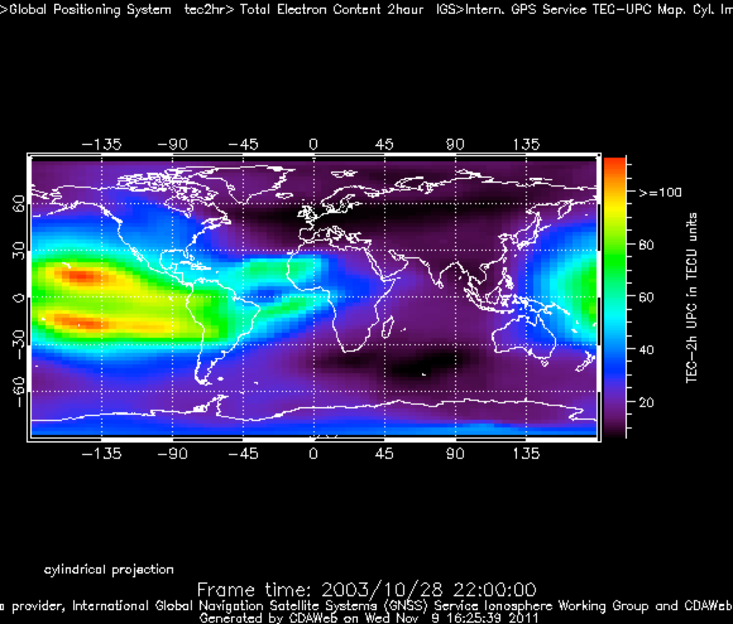
Parameter Display
Options in CDAWeb
WIND MFI & SWE
Van Allen Probe A ECT & MagEIS
GPS International GNSS Service Total Electron Content
TIMED/TIDI Wind Vectors Movie
Transverse Mercator Projection

Slide 10
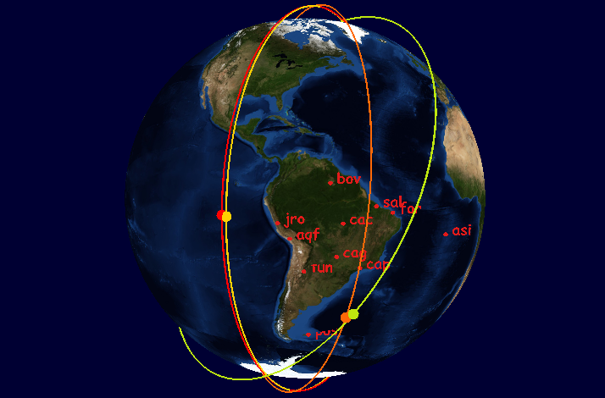

Science-Enabling Service # 2
Satellite Situation Center (SSCWeb)
Include most heliospheric satellites and many ground stations
Plot and list orbits of multiple s/c in a variety of coordinate systems
4D Orbit Viewer: Interactive 4D animation of orbits
Query for satellite-satellite and satellite-ground station conjunction
Simulated ICON+SWARM coverage in GOLD FOV
Extended Orbit Predicts : August 2021
Notes:
4D Orbit Viewer uses SSCWeb application programming interface (API) to access s/c database
SSCWeb also computes radial and magnetic field line conjunctions between satellites and ground stations

Slide 11
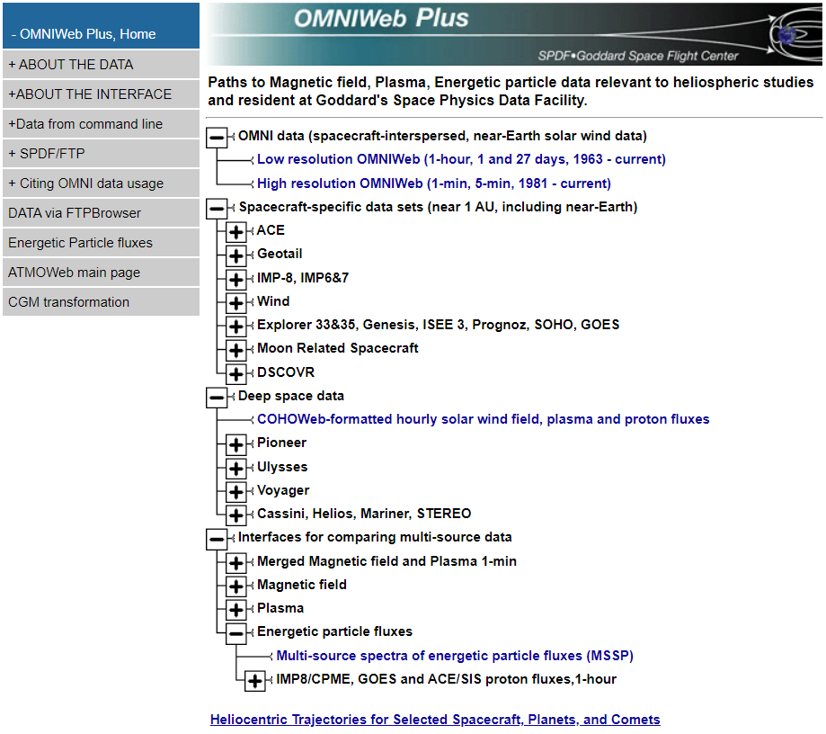
Science-Enabling Service # 3
OMNIWeb Plus
OMNI Data: Database of solar wind magnetic field and plasma parameters mapped to the nose of the Earth’s bow shock
Based on a large volume of quality-controlled satellite measurements (since Nov. 1963)
COHOWeb: Solar wind field, plasma, and proton fluxes in other locations of heliosphere, especially useful for planetary studies and heliospheric model validation
Interface for plotting, filtering, and downloading the data

Slide 12
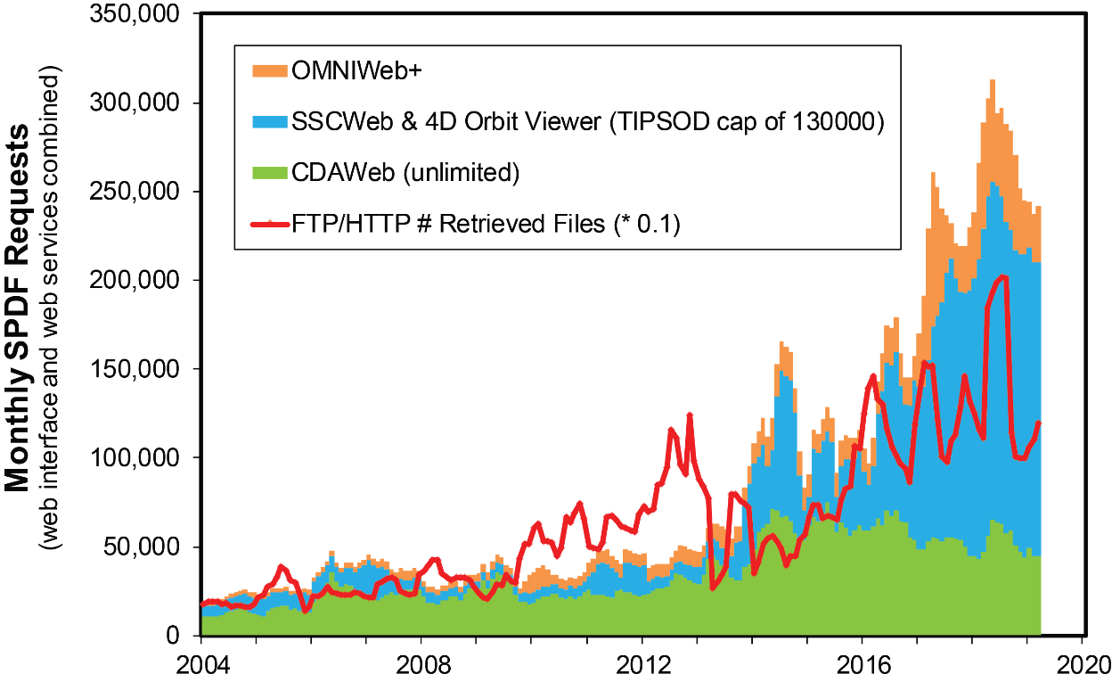
Extensive Use of SPDF Data & Services
The data and services provided by SPDF have facilitated global-scale, multi-mission heliophysics science
~30% of papers in AGU’s JGR Space Physics acknowledged SPDF services and/or data in recent years
Notes:
12

Slide 13
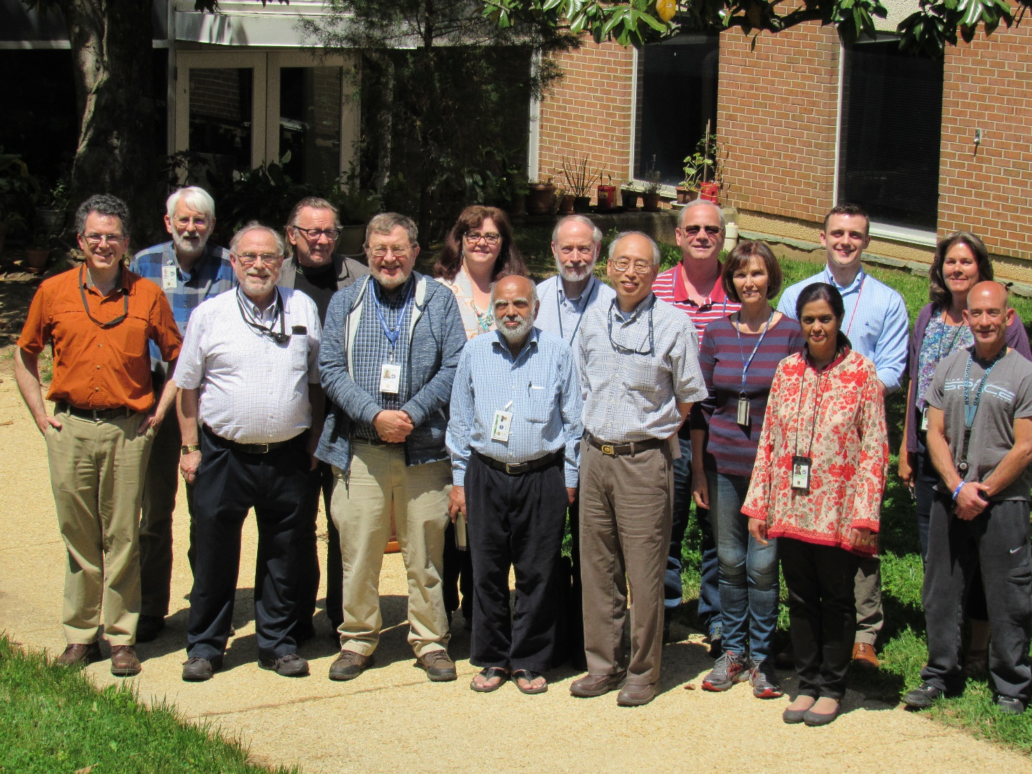
SPDF Group
Scientists
interacting
with missions
and acquiring
science data
Software
engineers and
IT experts
Lead:
Tami Kovalick
+ Natalia
Papitashvili
+ Lan Jian
Retired:
Bob Mcguire

Slide 14
Summary
SPDF aims to find, ingest, and preserve long-term and ensure ongoing (online) useful access to in situ NASA heliophysics science data
SPDF provides three main science-enabling services besides archiving data
  CDAWeb: browse, correlate, and display
  SSCWeb: orbit/ground track displays and queries
  OMNIWeb Plus: solar wind conditions at critical locations
SPDF enables multi-instrument, multi-mission heliophysics science
  Specific mission/instrument data in context of other missions/data
  Specific mission/instrument data as enriching context for other data
  Ancillary services & software (orbits, data standards, special products)
SPDF also helps building critical infrastructures for heliophysics data environment: CDF, Heliophysics Data Portal

