Slide 1
Data Analysis Enabled by the Space Physics Data Facility
Eric Grimes*, Lan Jian, Robert Candey, Tamara Kovalick,
and the Rest of SPDF Team
NASA Goddard Space Flight Center,
Greenbelt, MD, USA
https://spdf.gsfc.nasa.gov
Coupling, Energetics and Dynamics
of Atmospheric Regions (CEDAR)
San Diego, CA June 11, 2024
* Largely based on a presentation give by Lan Jian at this year’s TESS meeting

Slide 2
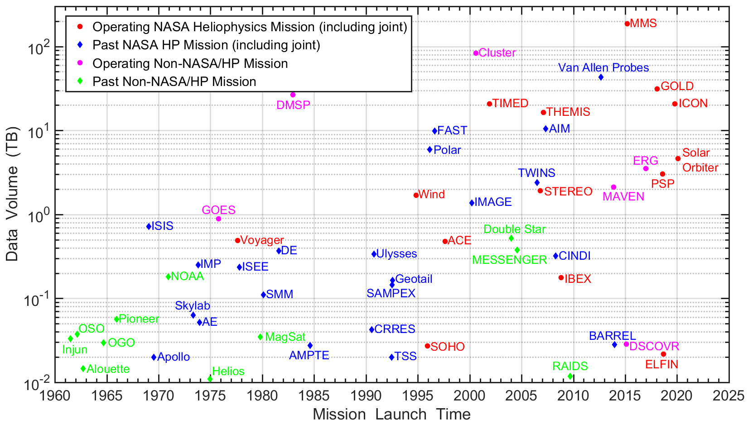
Introduction of SPDF
SPDF is the active and permanent archive of space physics data from NASA missions and joint missions with other US and foreign agencies (~3000 CDF datasets, ~5000 non-CDF datasets, ~100M files)

Slide 3
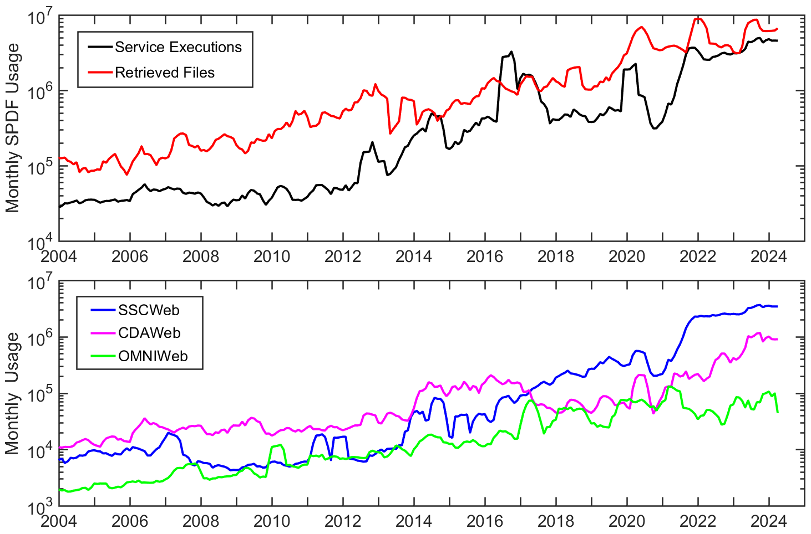
Science-Enabling Services of SPDF
Coordinated Data Analysis Web (CDAWeb)
  Data access through web browser, IDL, Python, API
  Interface for browsing and plotting data from 60+ missions or mission groups (audio, movie) and multiple instruments
  Inventory plot and usage statistics for mission data
Satellite Situation Center (SSC)
  ~200 spacecraft, orbit/ground track displays and queries
  Coordinate transformation
OMNIWeb (including COHOWeb)
  Solar wind plasma, magnetic field, and energetic particle data at the nose of Earth’s bow shock and other locations of the heliosphere
  Interface for plotting, filtering, and simple analysis
Notes:
SPDF, specifically, archives non-solar measurements from throughout the solar system and now interstellar space, and makes it available through various search and display services.
SPDF also hosts the development of the CDF data format, and the Heliophysics Data Portal for searching for all heliophysics data and other resources, located across the world.

Slide 4
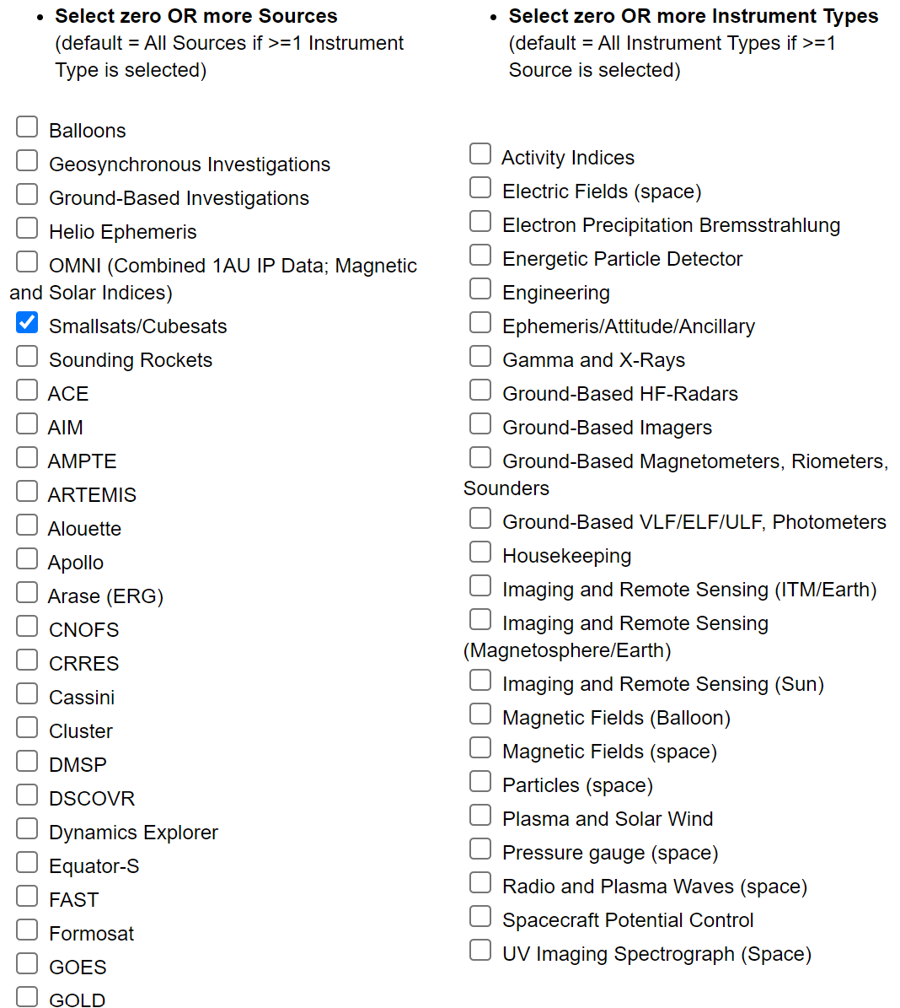
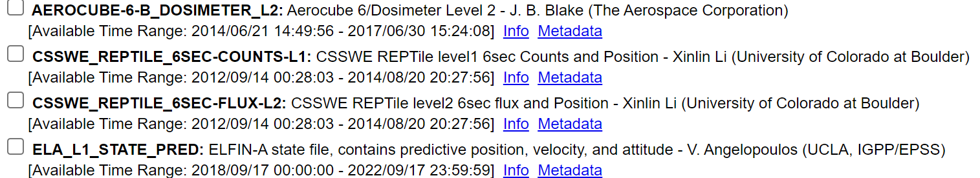
60+ Missions/Sources (Groups)
Coordinated Data
Analysis Web (CDAWeb)
https://cdaweb.gsfc.nasa.gov/
Enable multi-mission, multi-instrument science
Present dataset view rather than individual data files

Slide 5
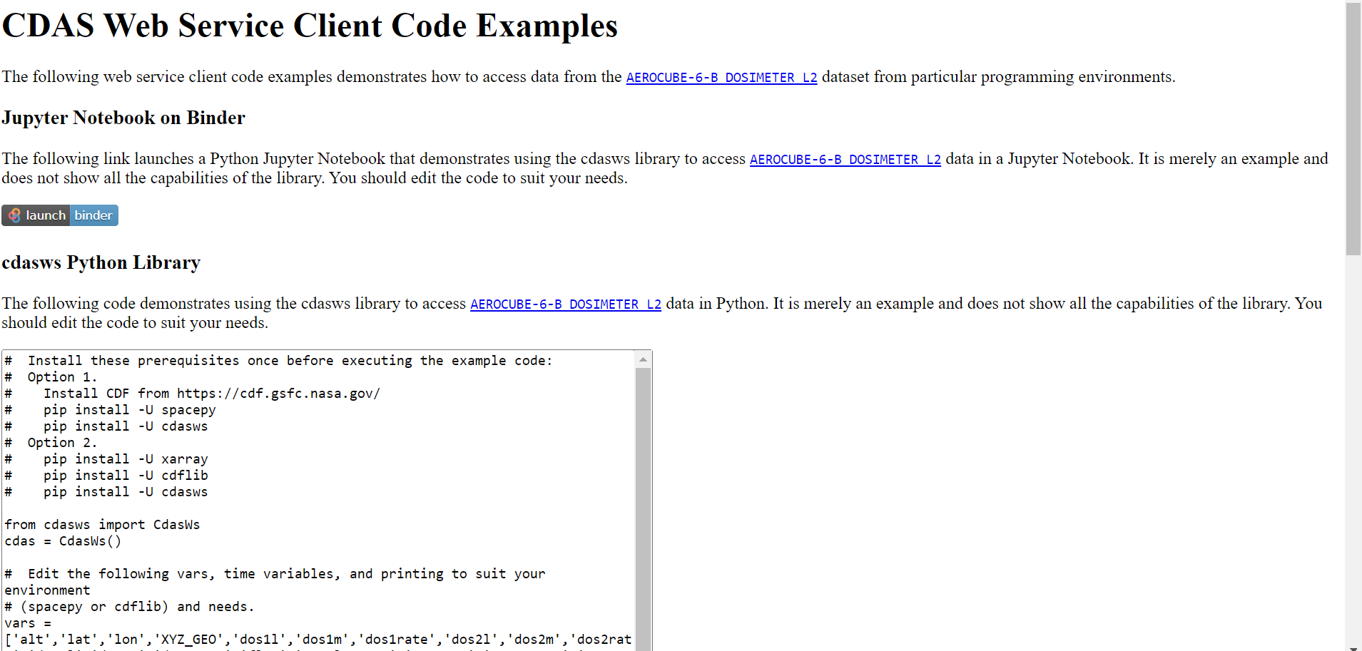
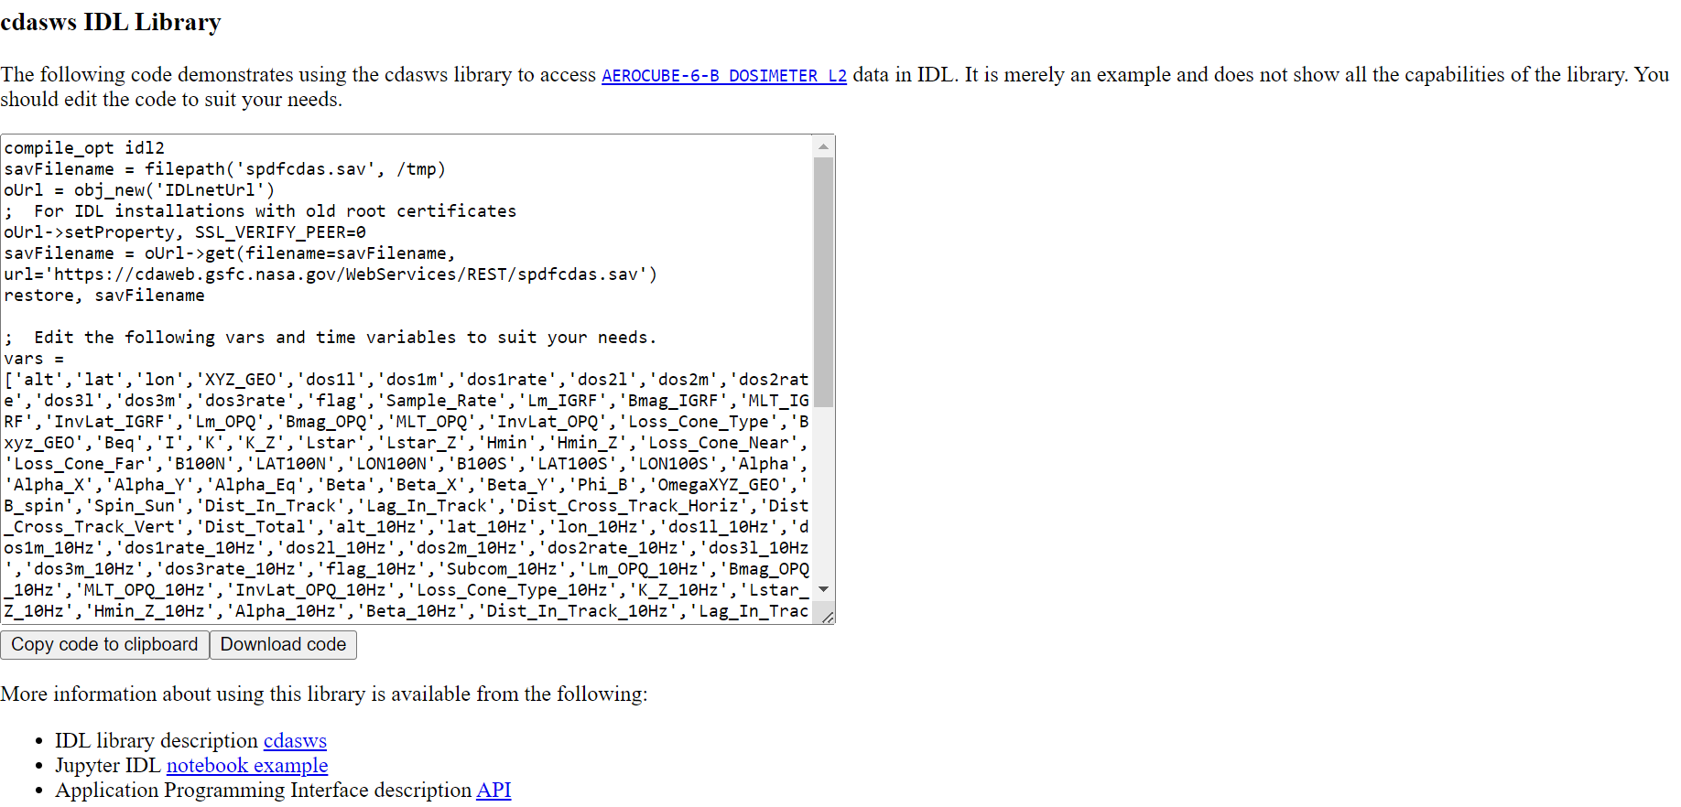

Slide 6
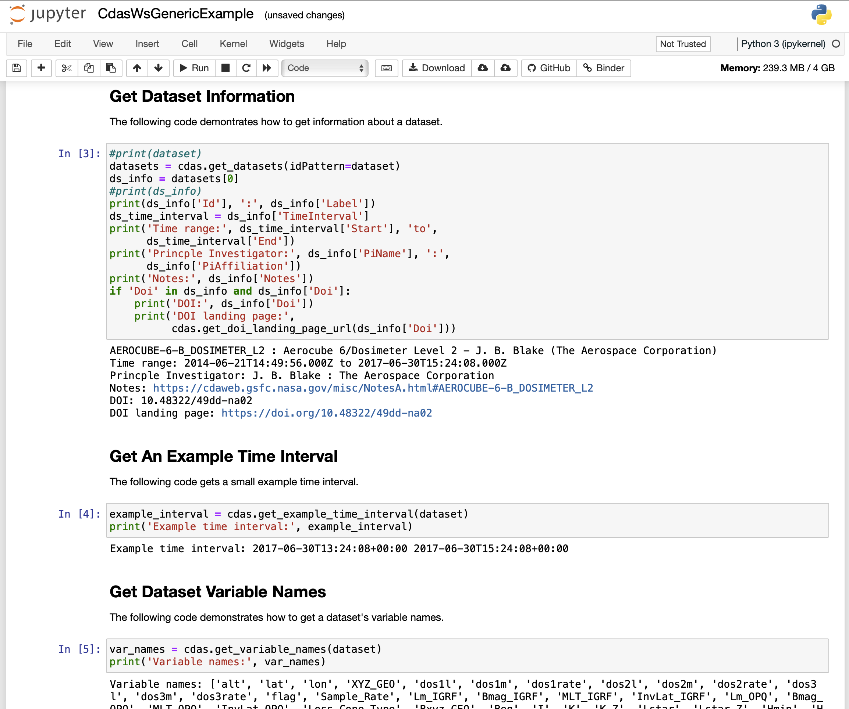

Slide 7
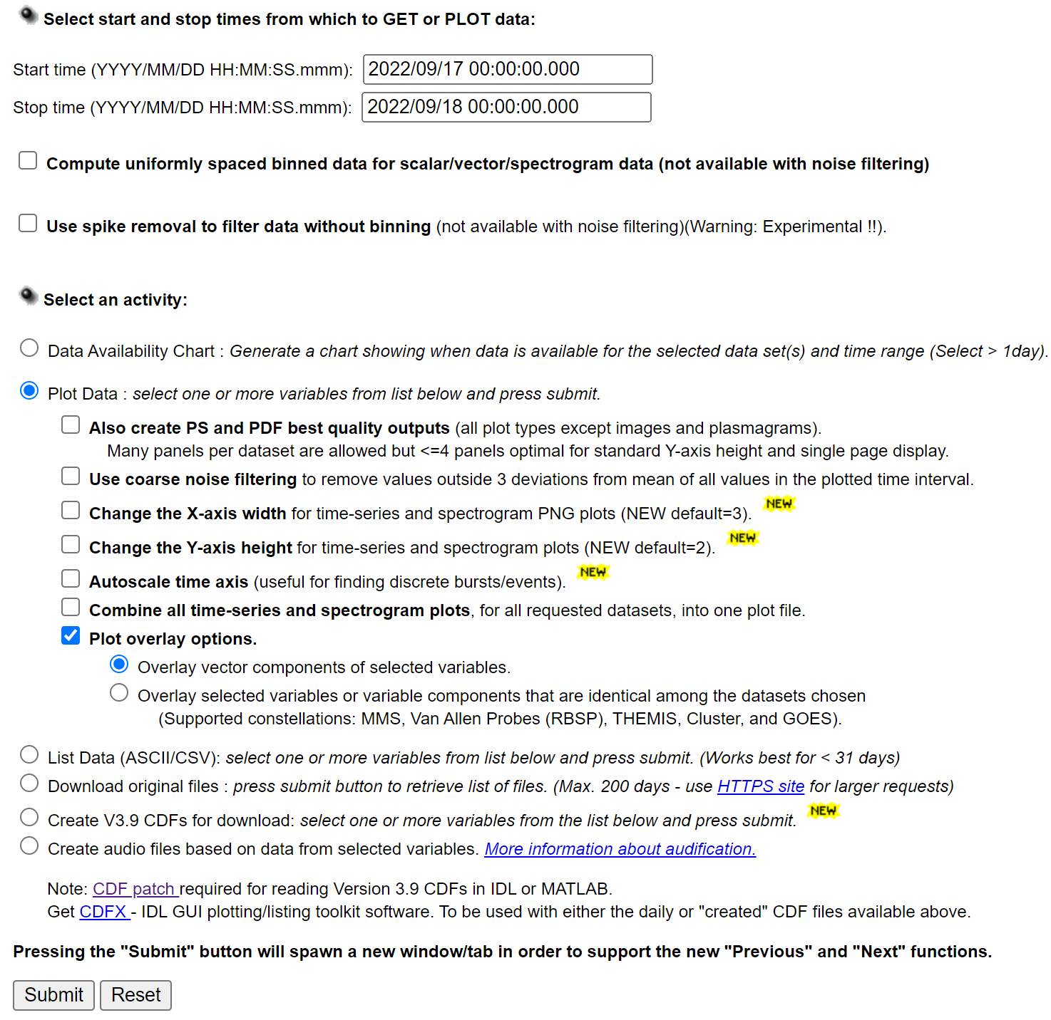
CDAWeb Data Explorer
Time interval is automatically set by the last available day of the selected dataset(s)
Remove spikes or filter coarse noise
Plot data availability
Adjust X and Y lengths for plotting
Auto scale time axis for finding discrete bursts or events
Overlay vector components of selected variables, or selected variables that are identical among multiple datasets
Output a subset or a superset of datasets in CDF, ASCII/CSV, JSON
Create audio and movie files for selected variables
Notes:
An ASCII delimited file is a text file with the extension .csv. All fields of a record are on one line, separated typically by commas.
JSON: JavaScript Object Notation, an open data interchange format that is both human and machine-readable.

Slide 8
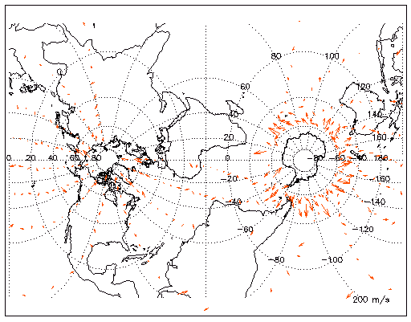
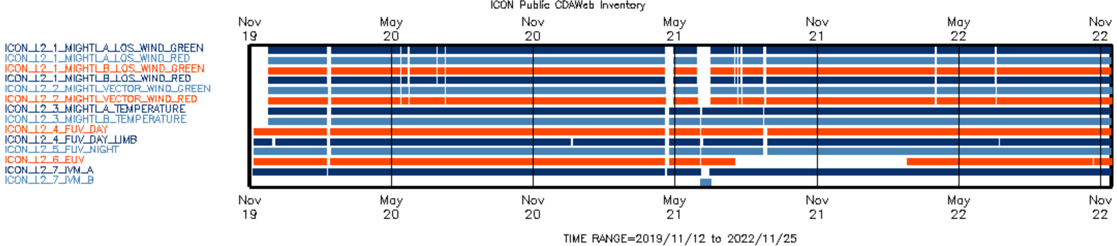
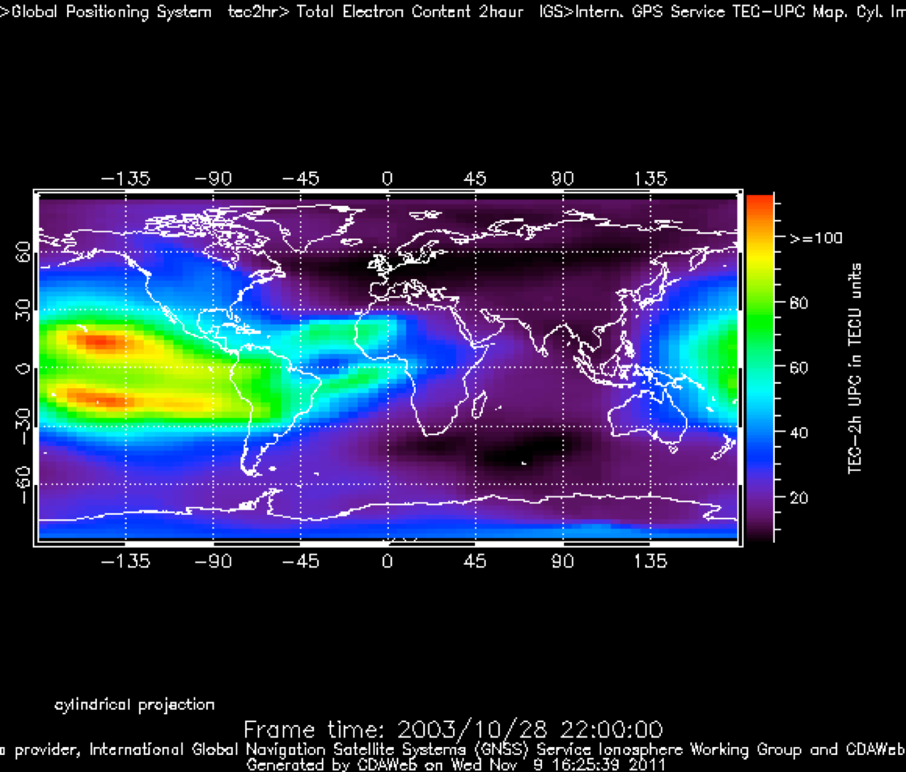
Parameter
Displays
in CDAWeb
GPS International GNSS Service Total Electron Content
TIMED/TIDI Wind Vectors Movie
Transverse Mercator Projection
Inventory Plot for Mission Datasets

Slide 9
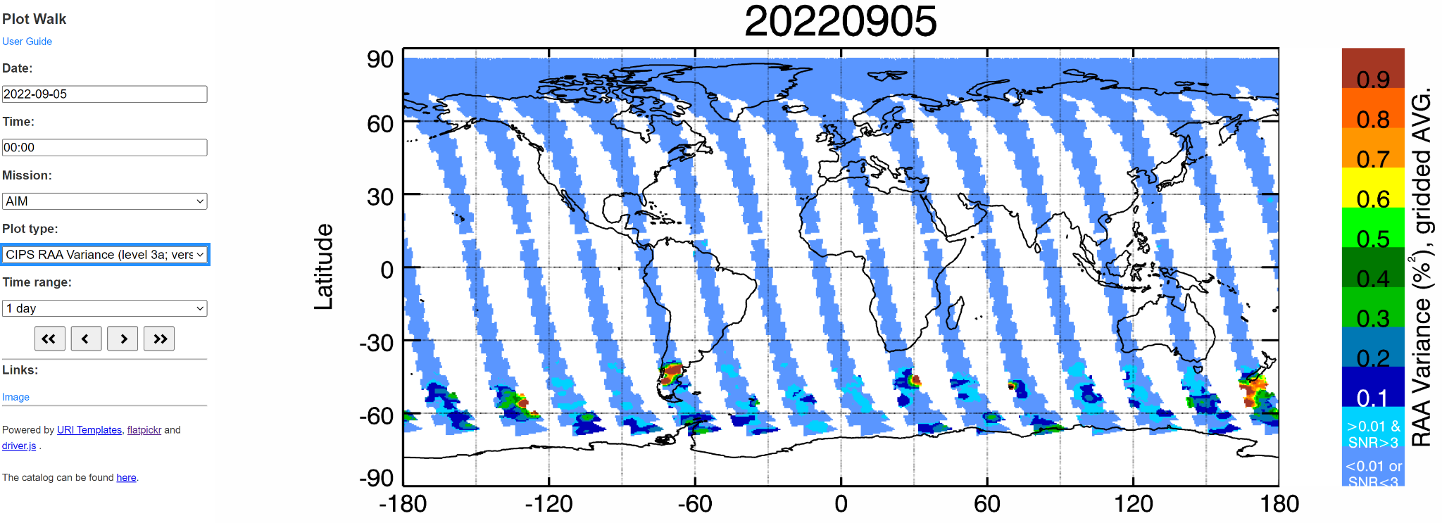
Plot Walk for Pre-Generated Plots
https://spdf.gsfc.nasa.gov/plot_walk/
Summary or quick-look plots from 20+ missions (12 million plots)
(links for readme, PDF, PS files)
Rayleigh Albedo Anomaly (RAA) variance from Cloud Imaging and Particle Size instrument (CIPS) of the Aeronomy of Ice in the Mesosphere (AIM) mission

Slide 10
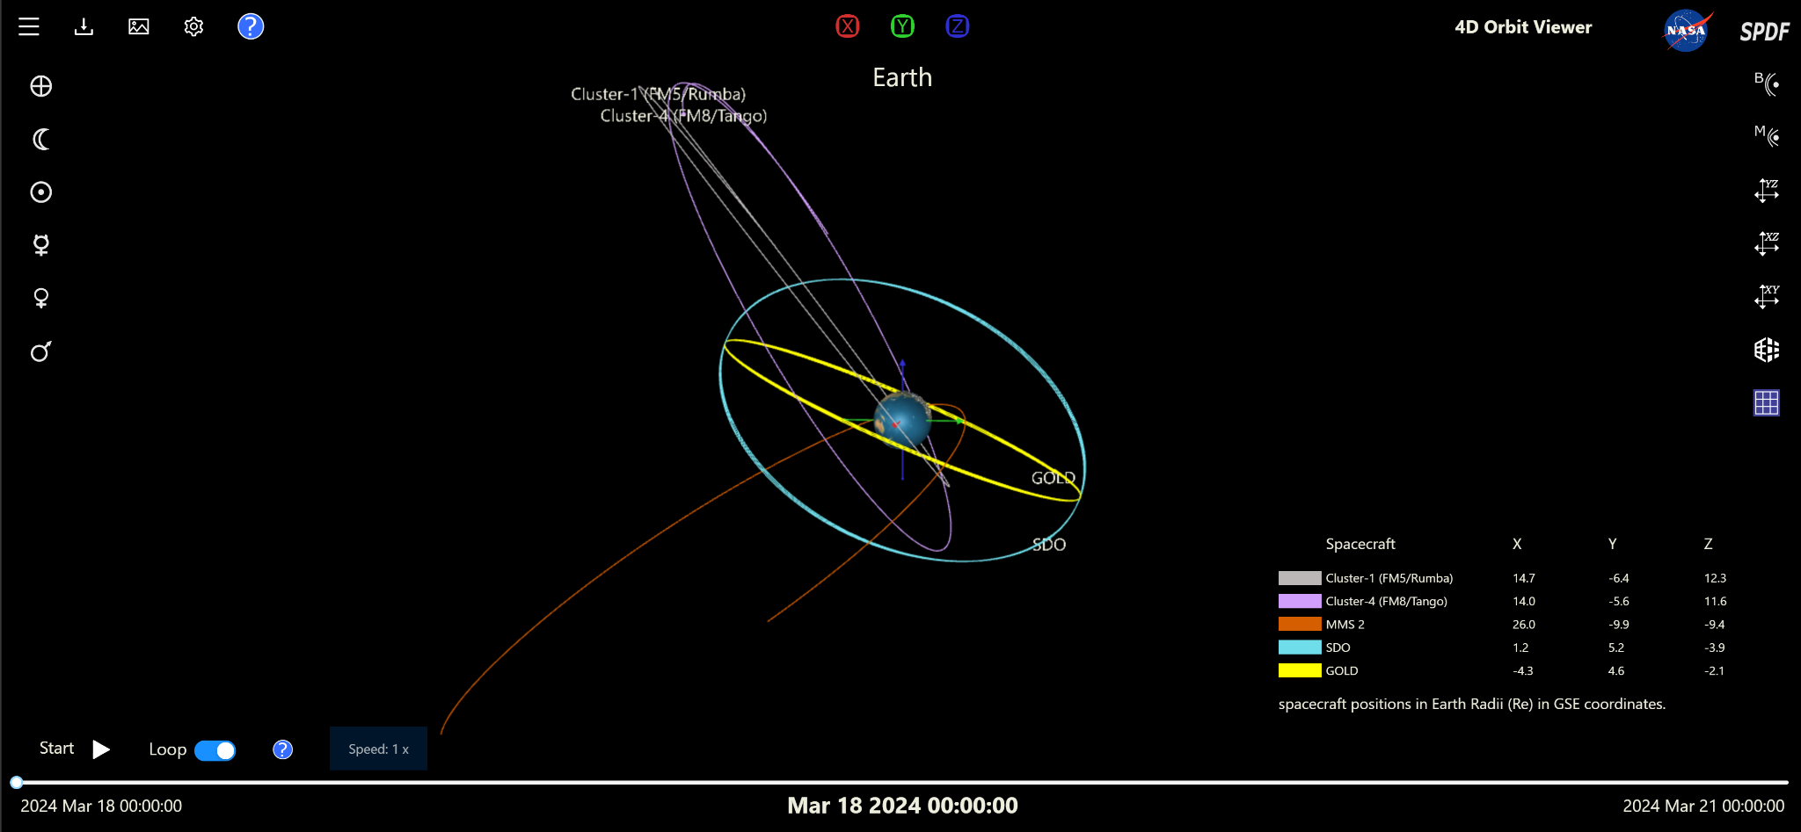
4-D Orbit Viewer (~200 Spacecraft)
https://sscweb.gsfc.nasa.gov/4dorbit/
bow shock
magnetopause
switch to perspective camera

Slide 11
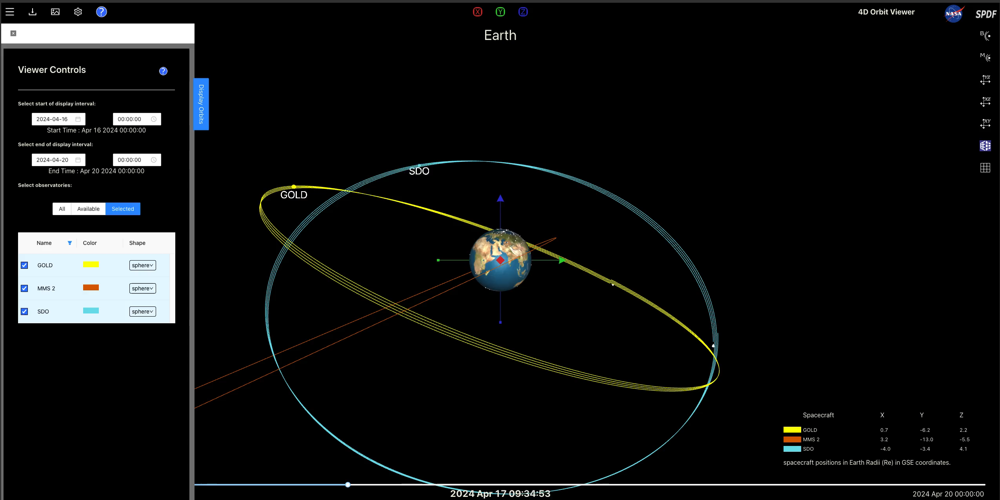
4-D Orbit Viewer (~200 Spacecraft)
https://sscweb.gsfc.nasa.gov/4dorbit/
Notes:
Play video here

Slide 12
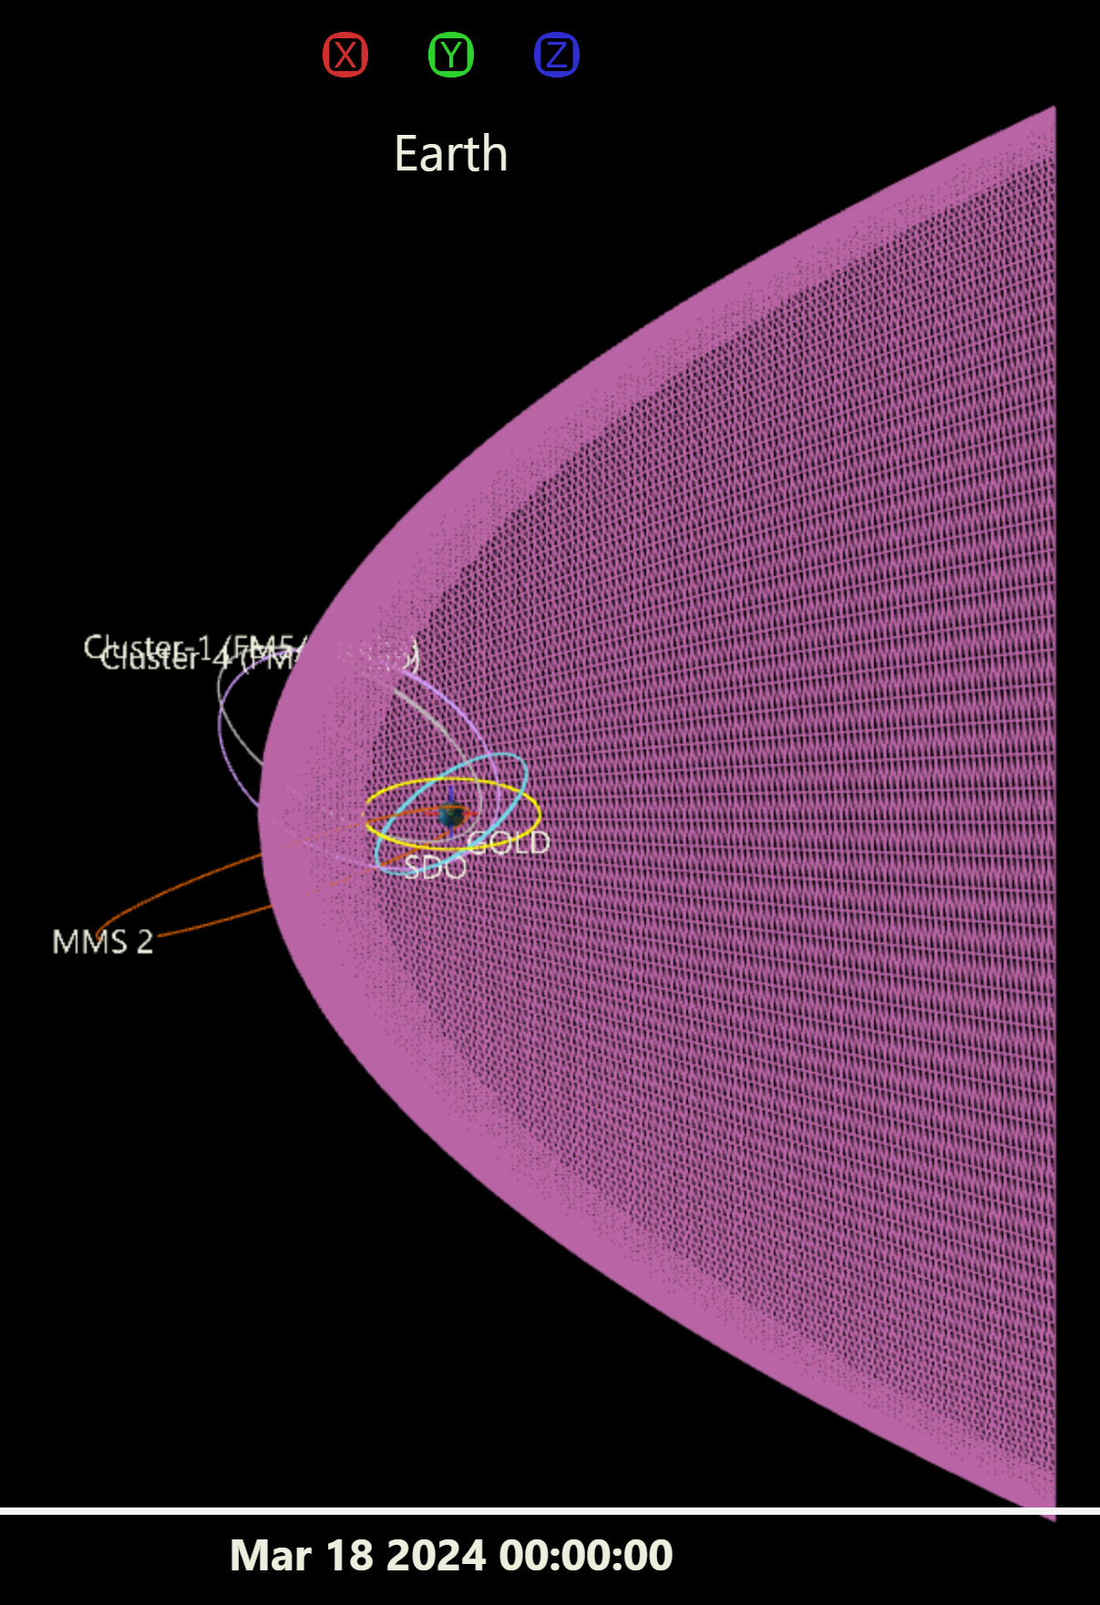
4-D Orbit Viewer
bow shock

Slide 13
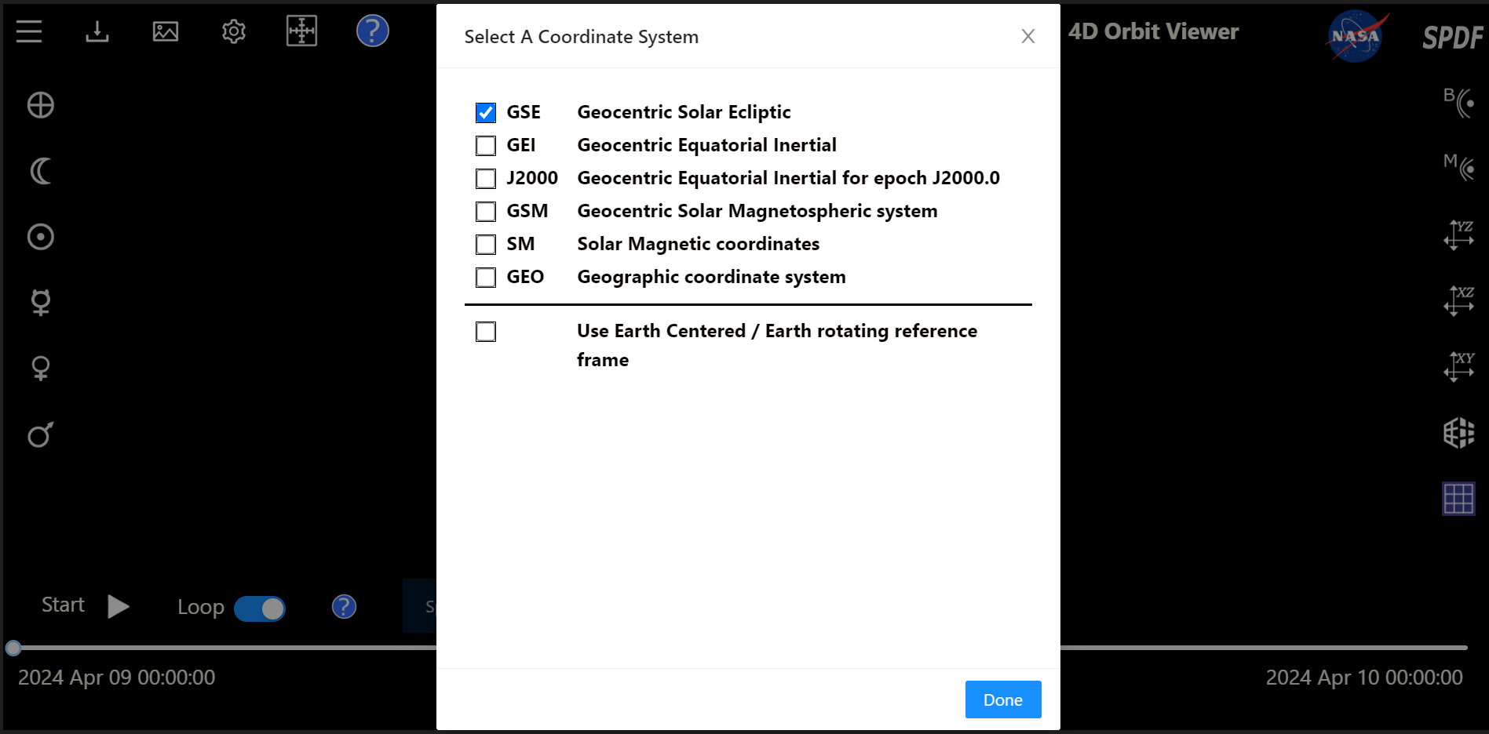
4-D Orbit Viewer: Different Coordinates

Slide 14
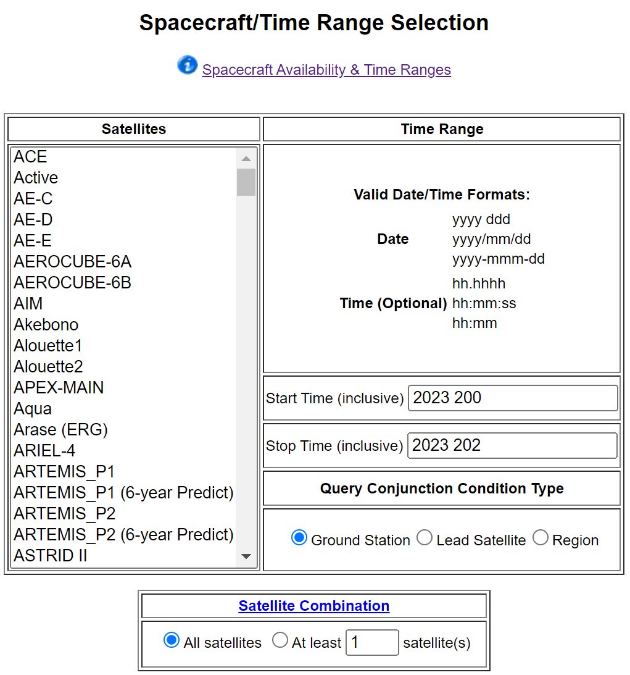
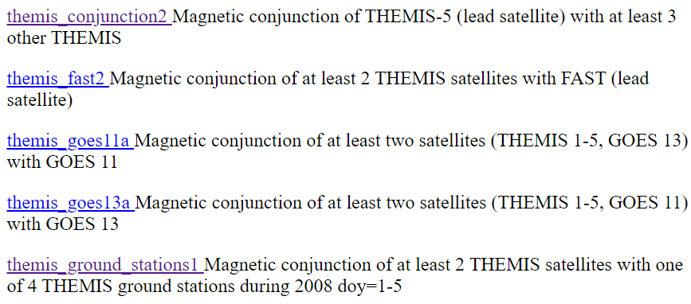
Spacecraft Situation Center Conjunction Query
Example Using THEMIS Mission
https://sscweb.gsfc.nasa.gov/examples/THEMIS_queries/

Slide 15
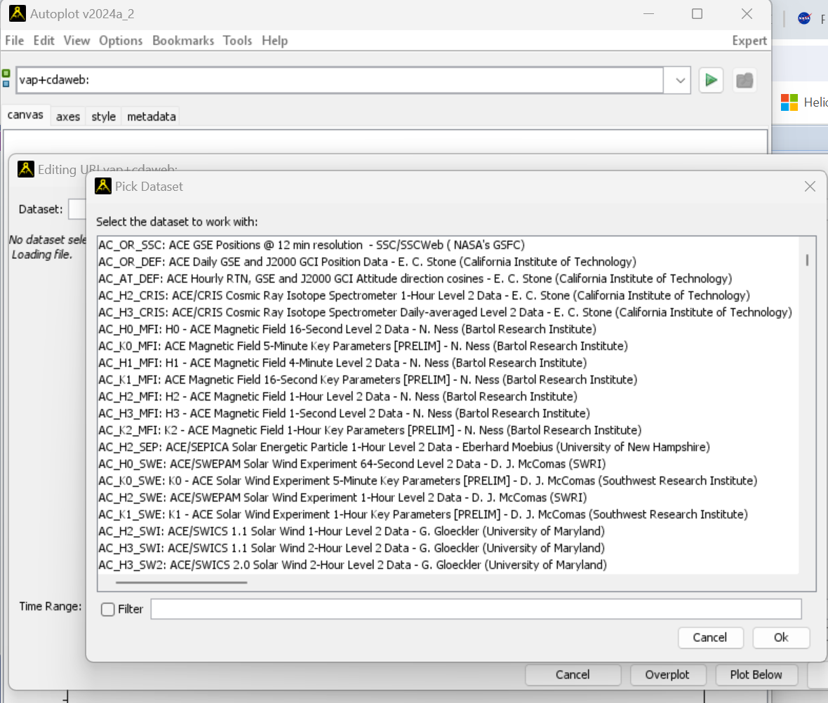
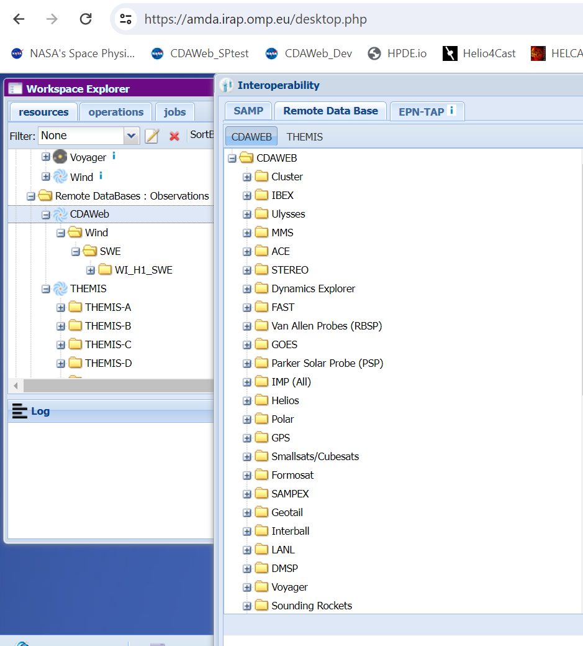
CDAWeb Datasets Are Available at
HelioCloud, PySPEDAS, Autoplot, AMDA, etc.
Autoplot
Automated Multi-Dataset Analysis (AMDA)

Slide 16
Summary
SPDF archives and serves observational space physics data relevant to NASA heliophysics science objectives in order to promote correlative and collaborative research across discipline and mission boundaries
SPDF provides three main science-enabling services: CDAWeb, SSCWeb, and COHOWeb
SPDF welcomes community feedback/input to improve our services
  Updating the ISTP metadata standards
  Serving research generated data and plots
  Developing more interactive data explorer (e.g., making multi-dimensional data more digestible rather than depending on heavy usage of additional software packages)

